Slide 1
natl_gaps_no_action
1 US WTIV starting with CVOW

Slide 2
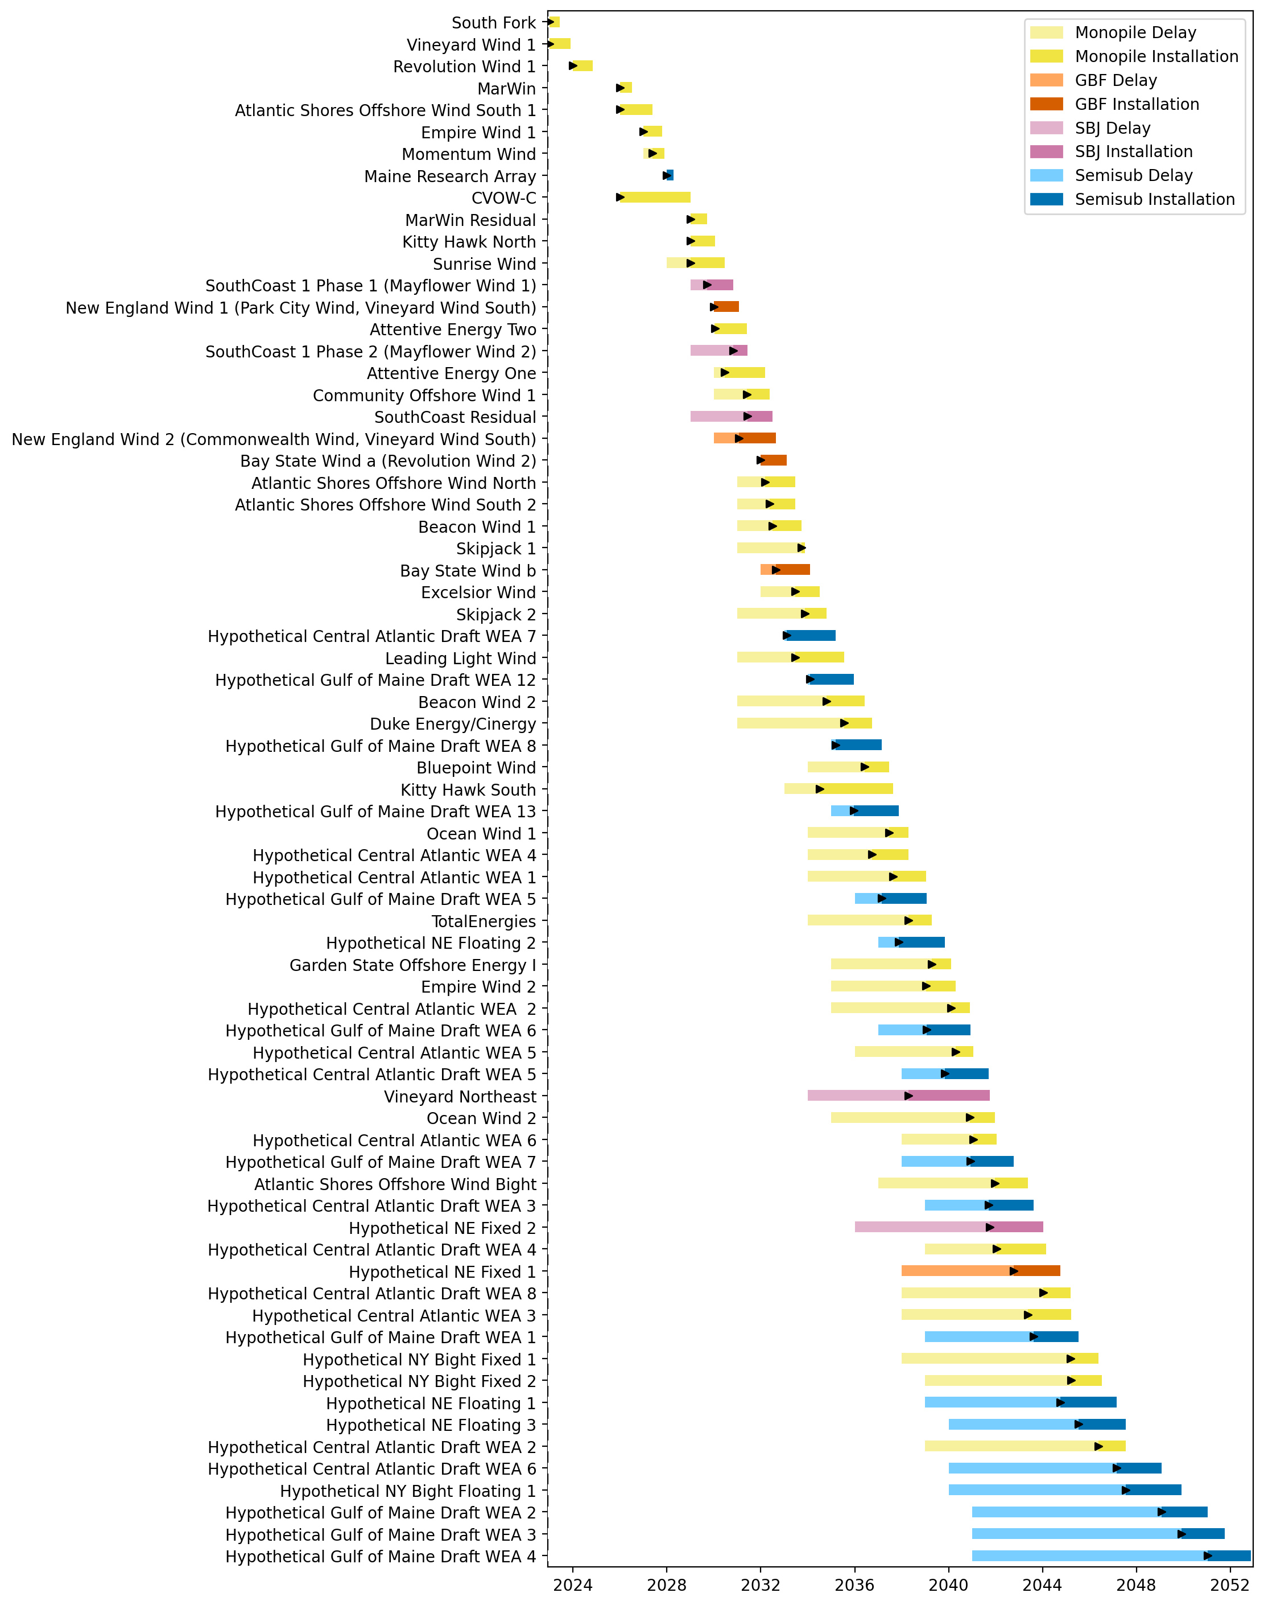
Full Gantt

Slide 3
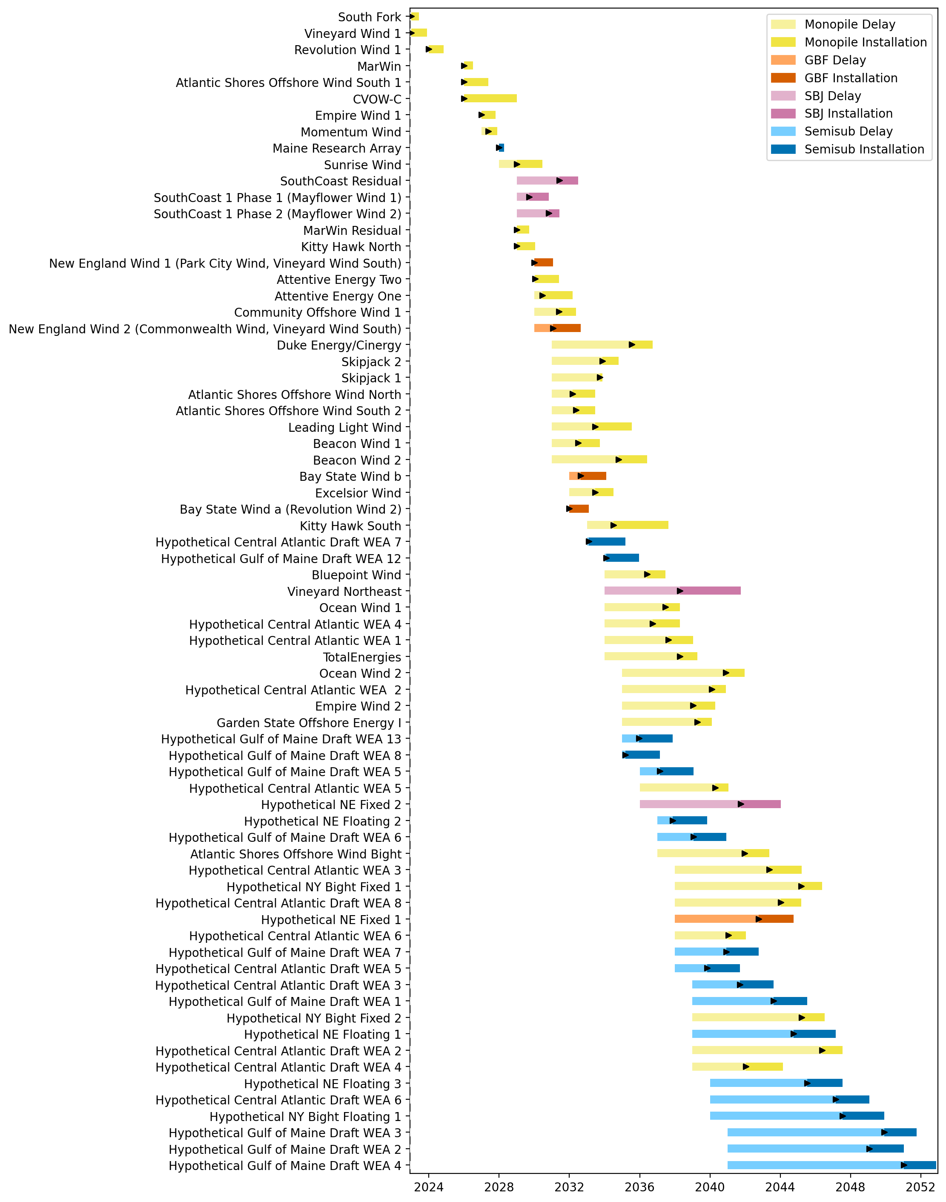
Sorted Full Gantt

Slide 4
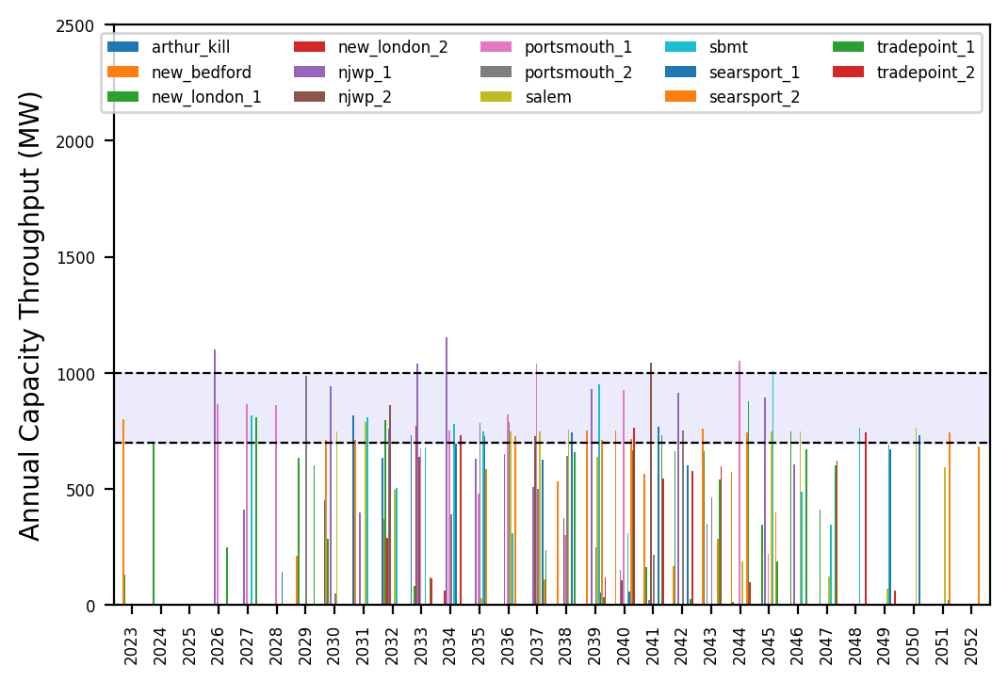
Port Throughput

Slide 5
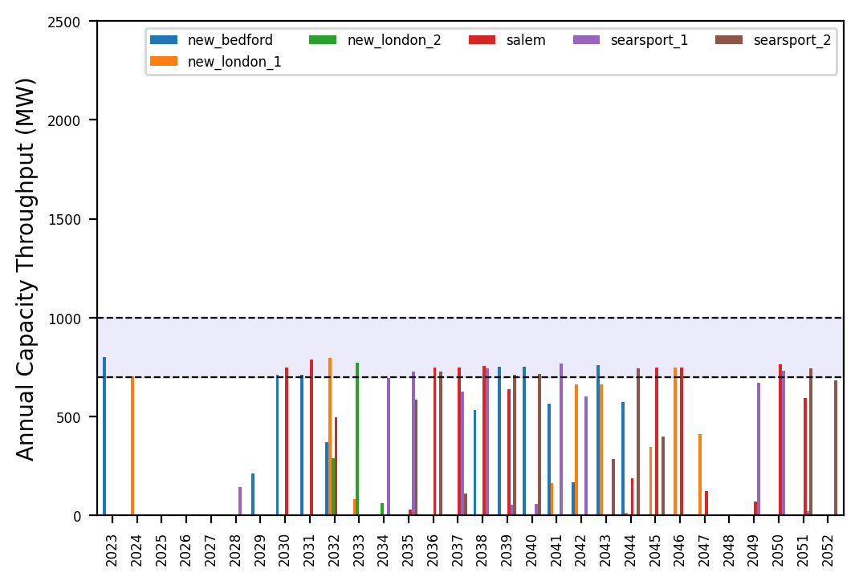
Port Throughput

Slide 6
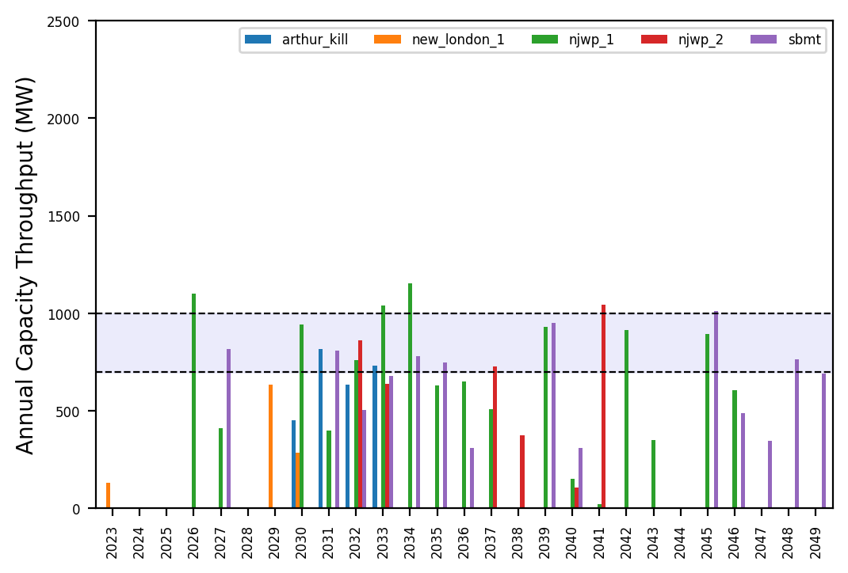
Port Throughput

Slide 7
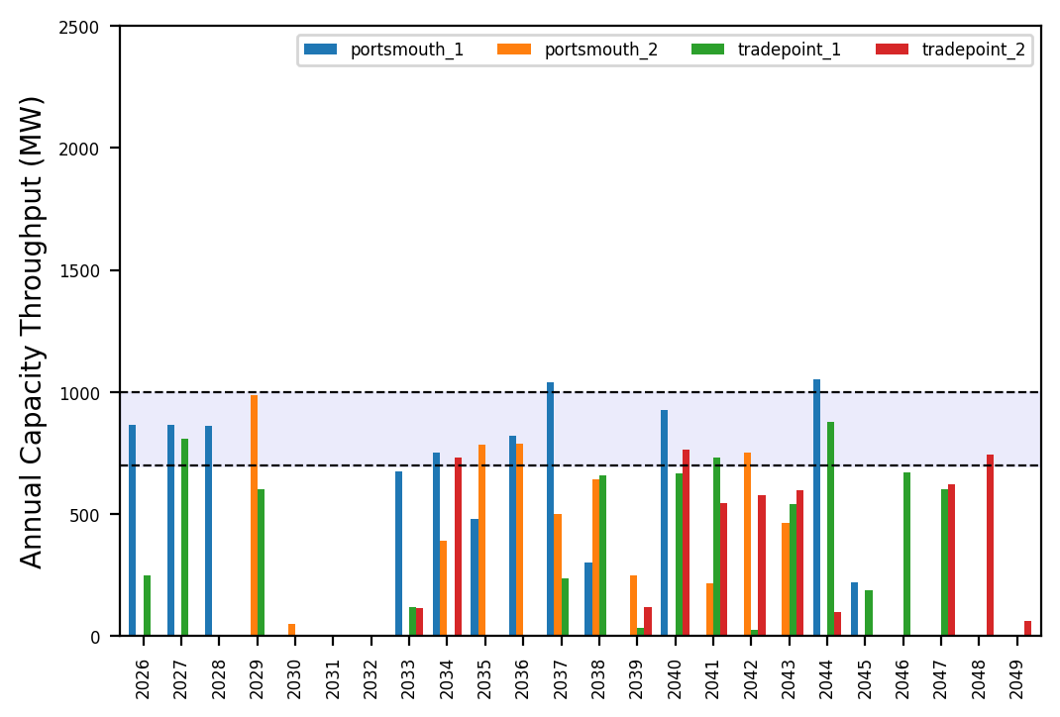
Port Throughput

Slide 8
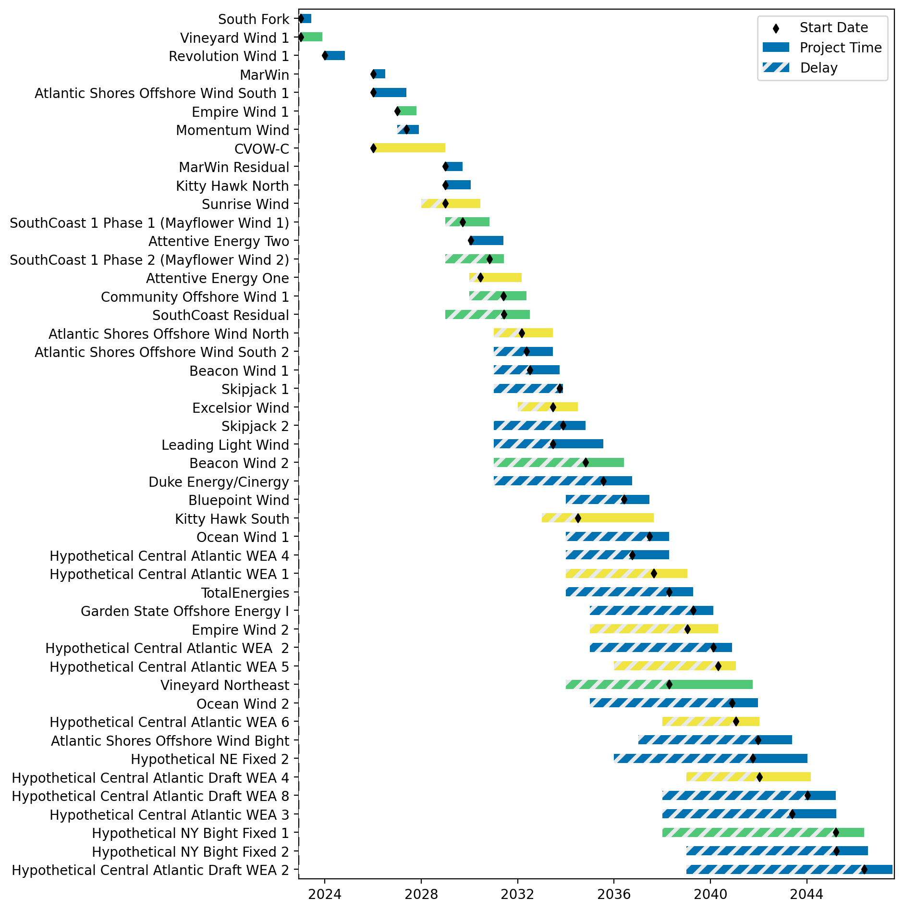
Fixed Gantt

Slide 9
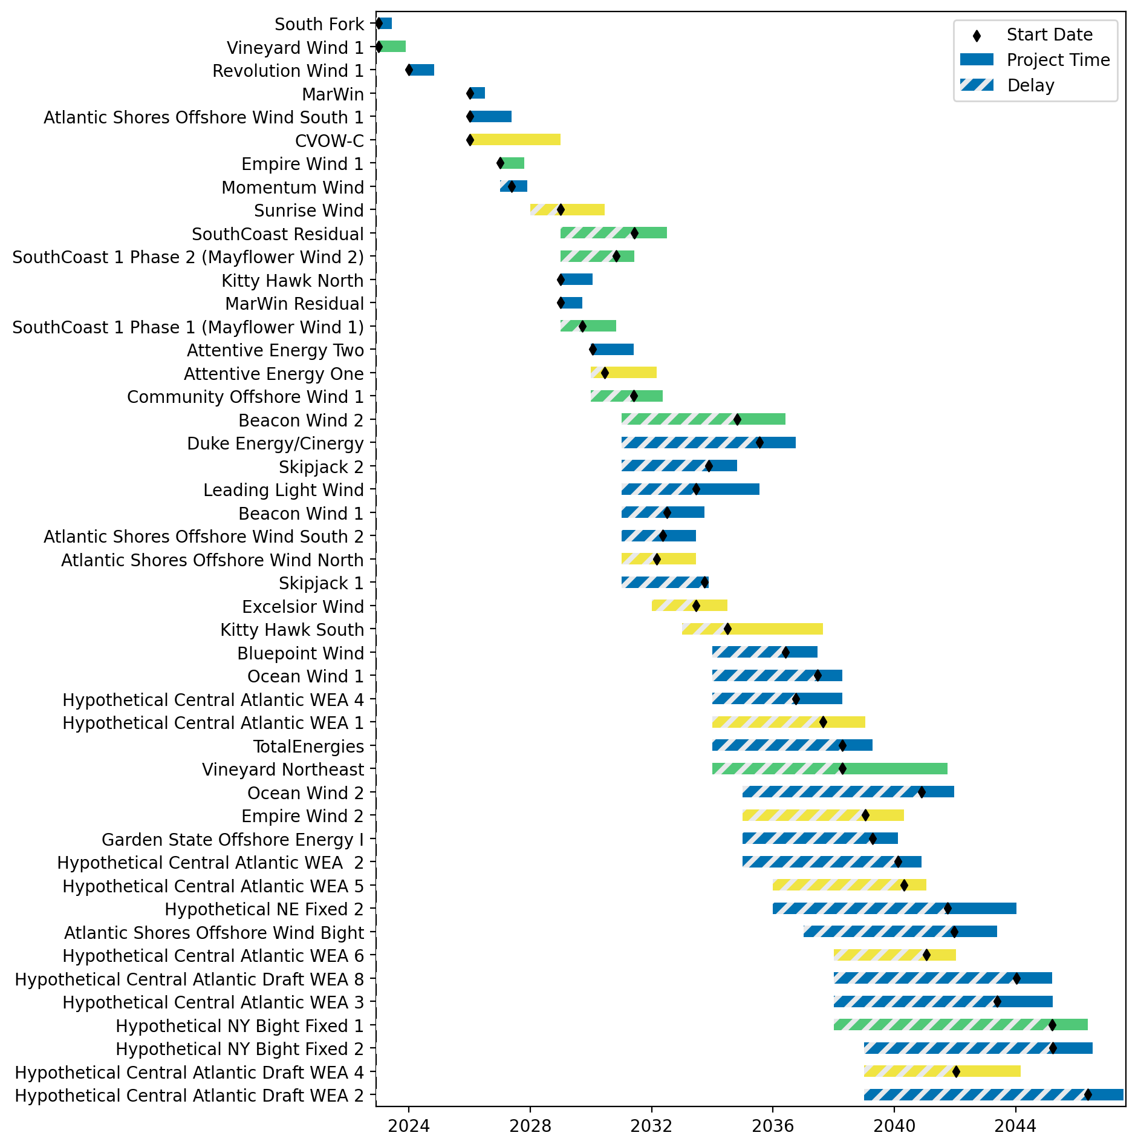
Sorted Fixed Gantt

Slide 10
natl_gaps_3foreign
1 more foreign WTIV 2025

Slide 11
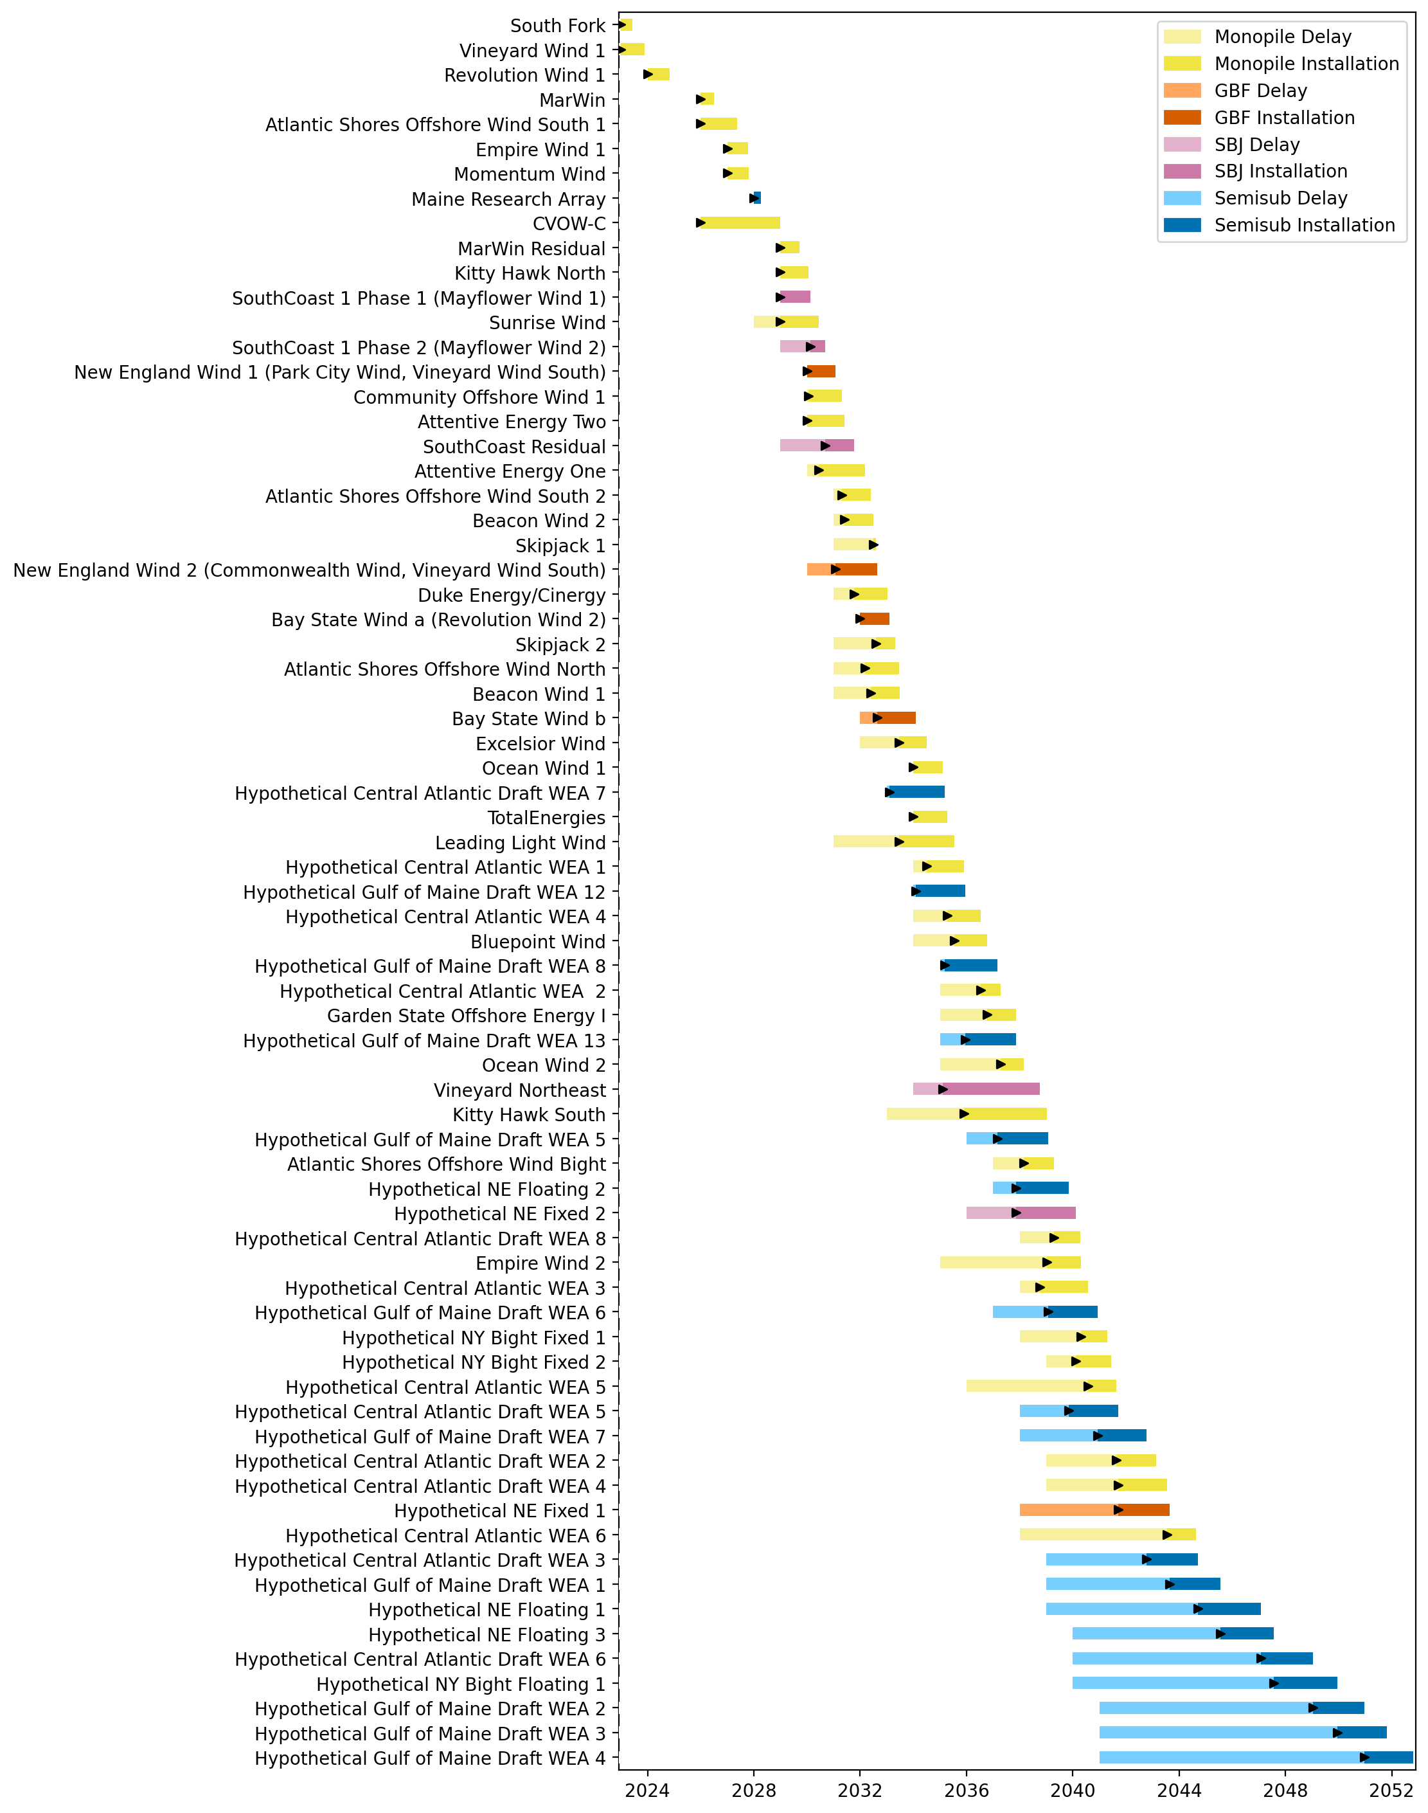
Full Gantt

Slide 12
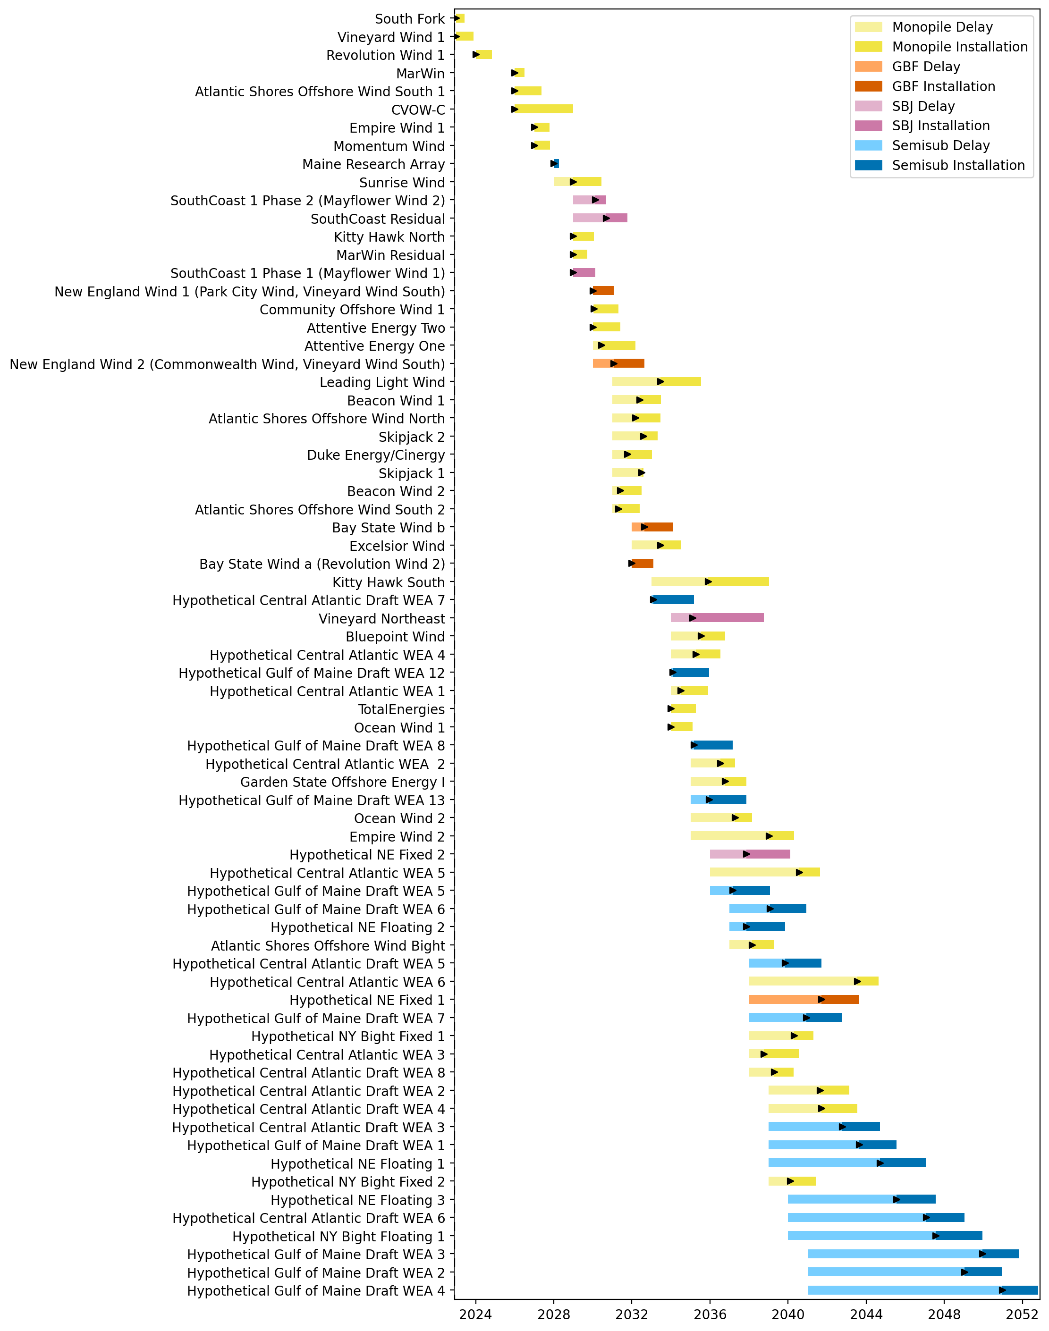
Sorted Full Gantt

Slide 13
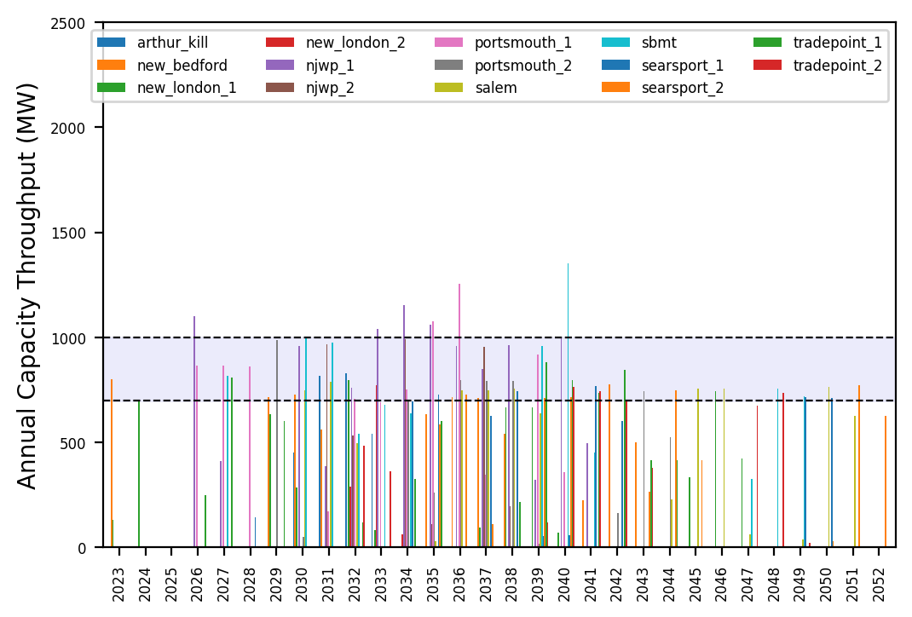
Port Throughput

Slide 14
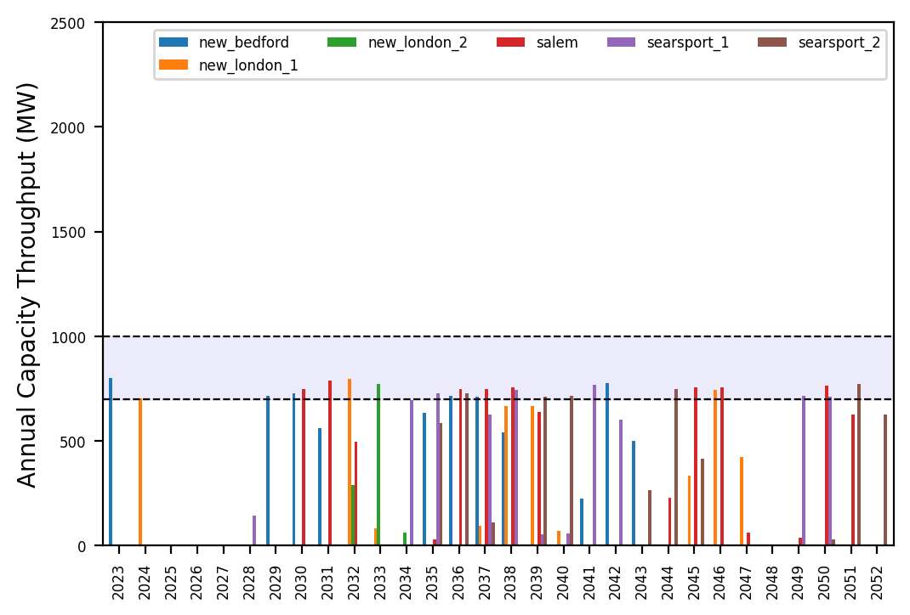
Port Throughput

Slide 15
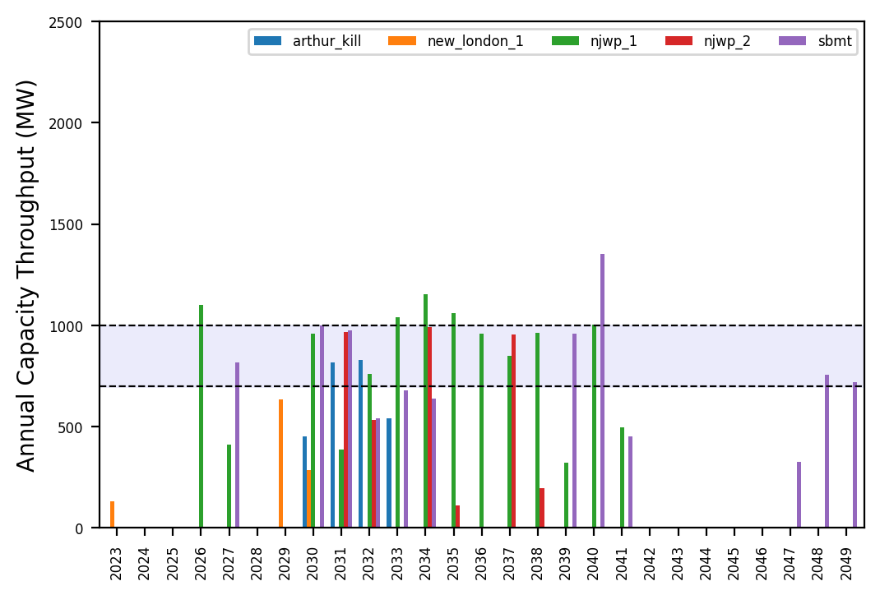
Port Throughput

Slide 16
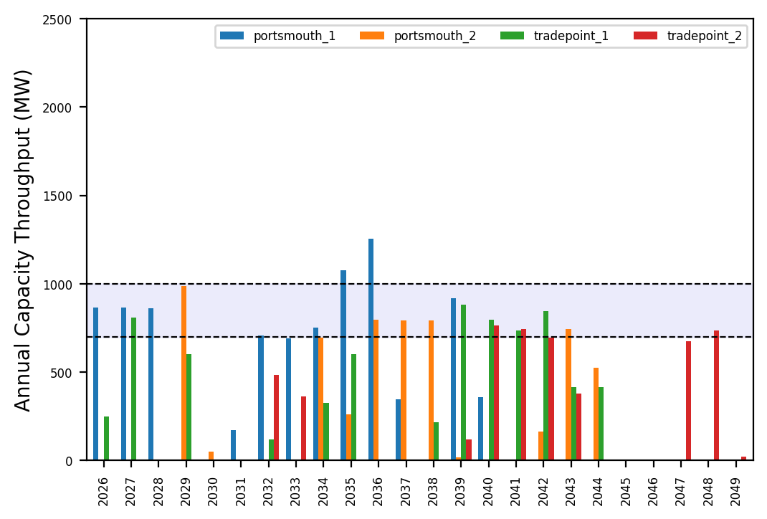
Port Throughput

Slide 17
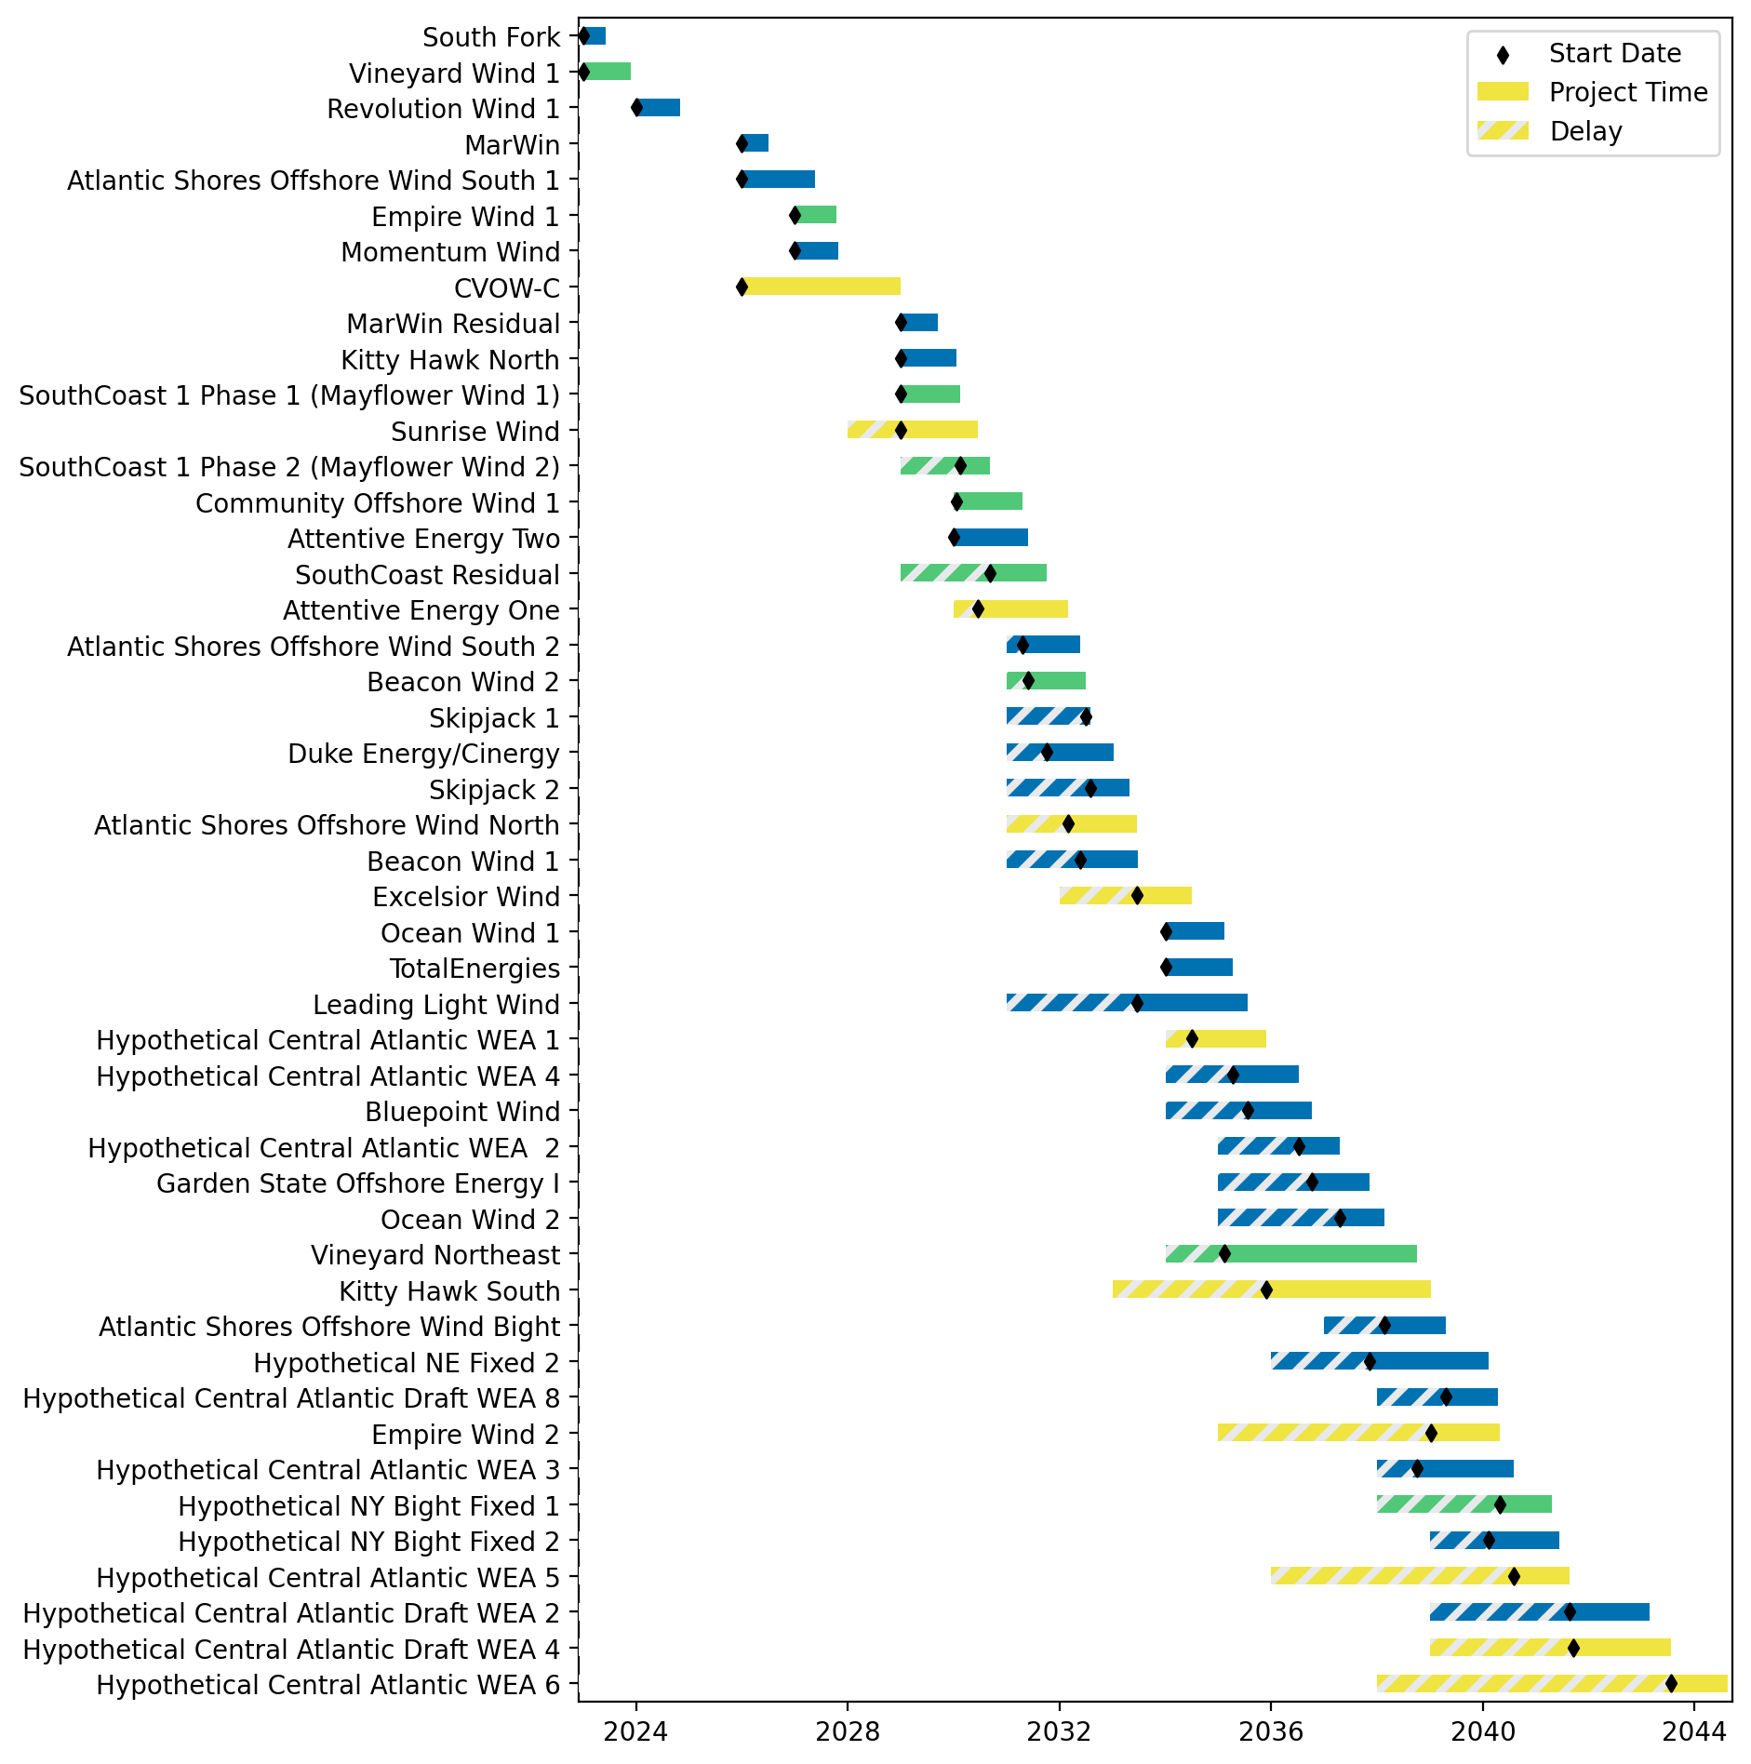
Fixed Gantt

Slide 18
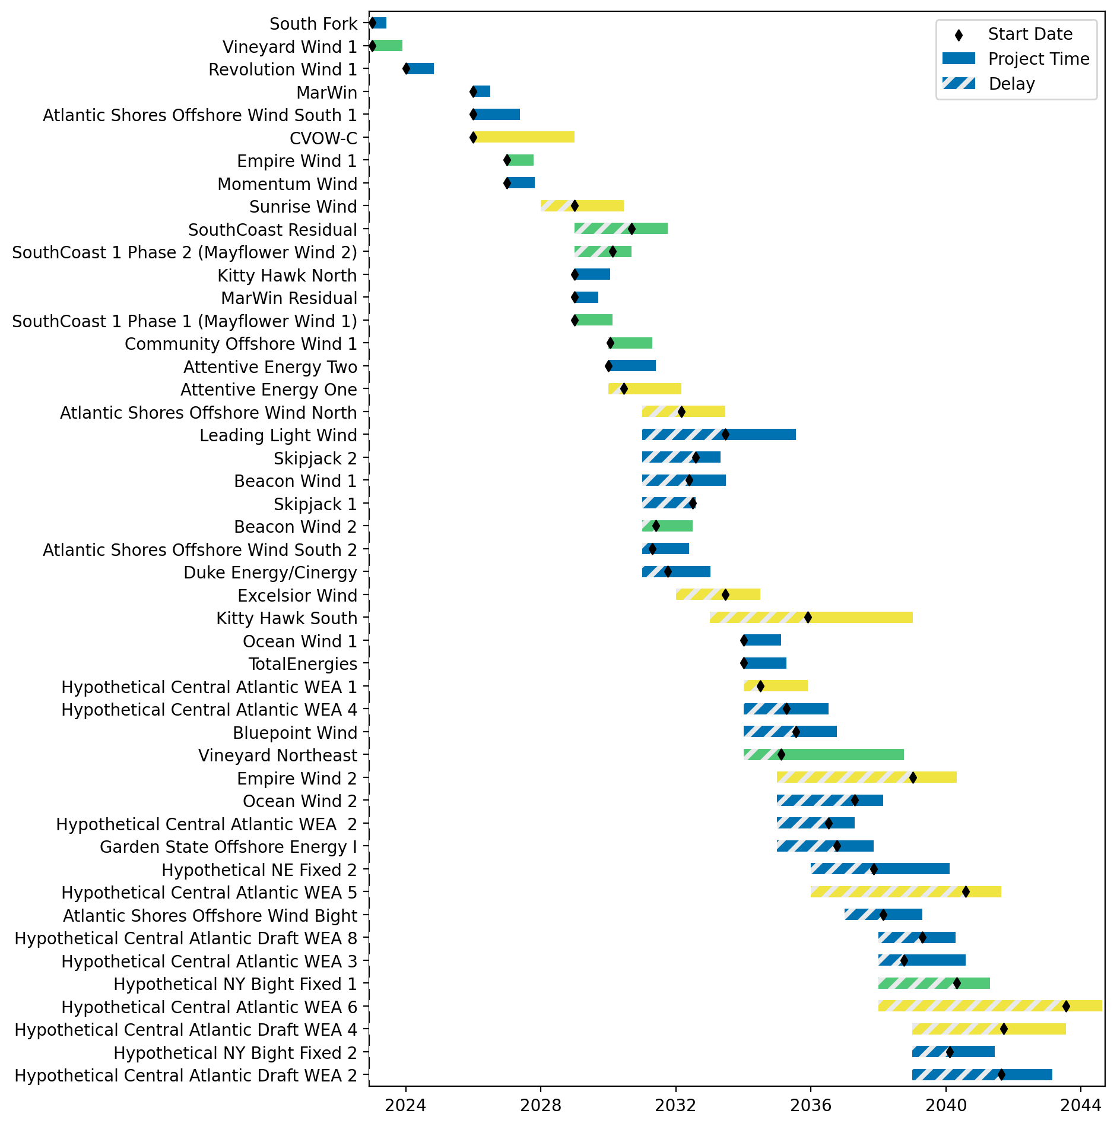
Sorted Fixed Gantt

Slide 19
natl_gaps_4foreign
1 more foreign WTIV 2025

Slide 20
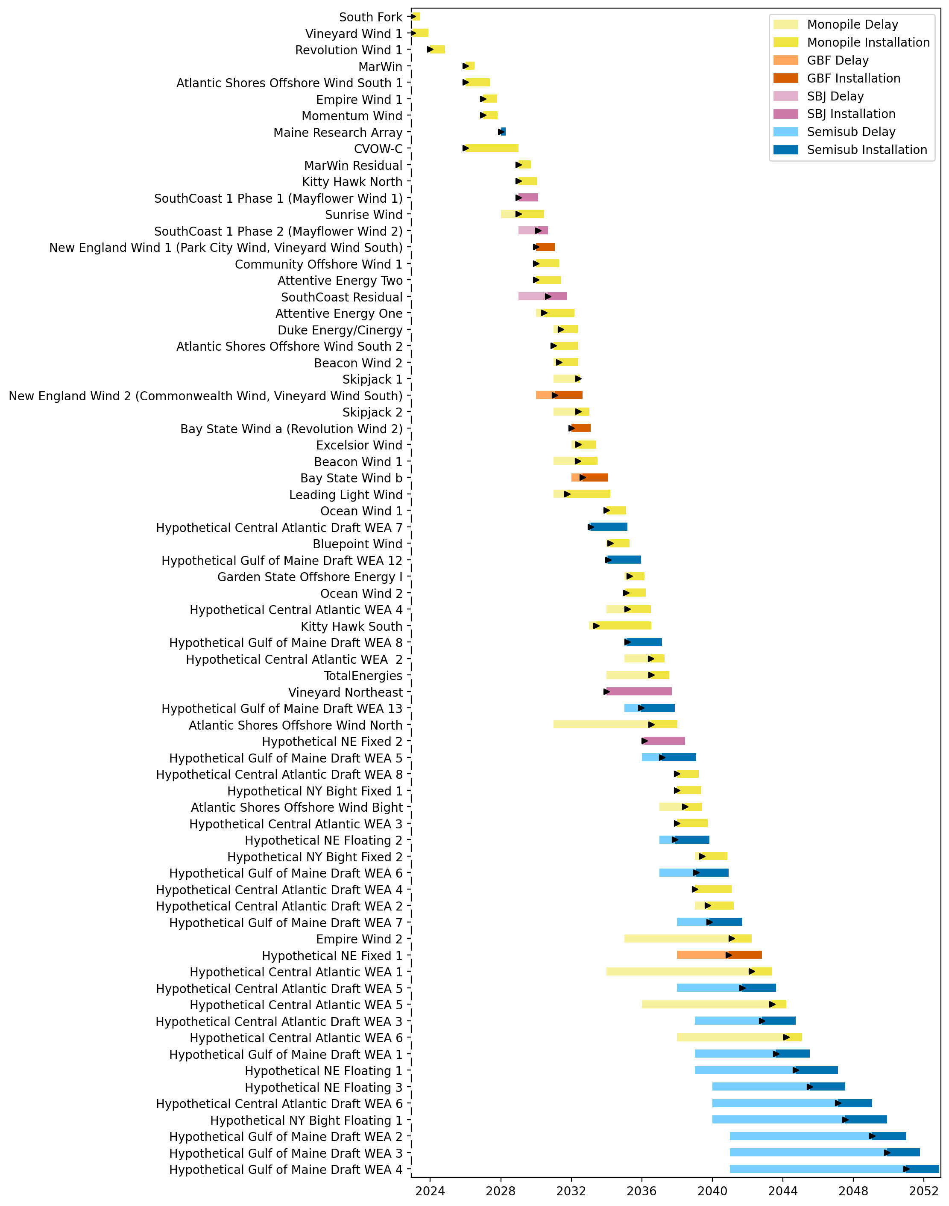
Full Gantt

Slide 21
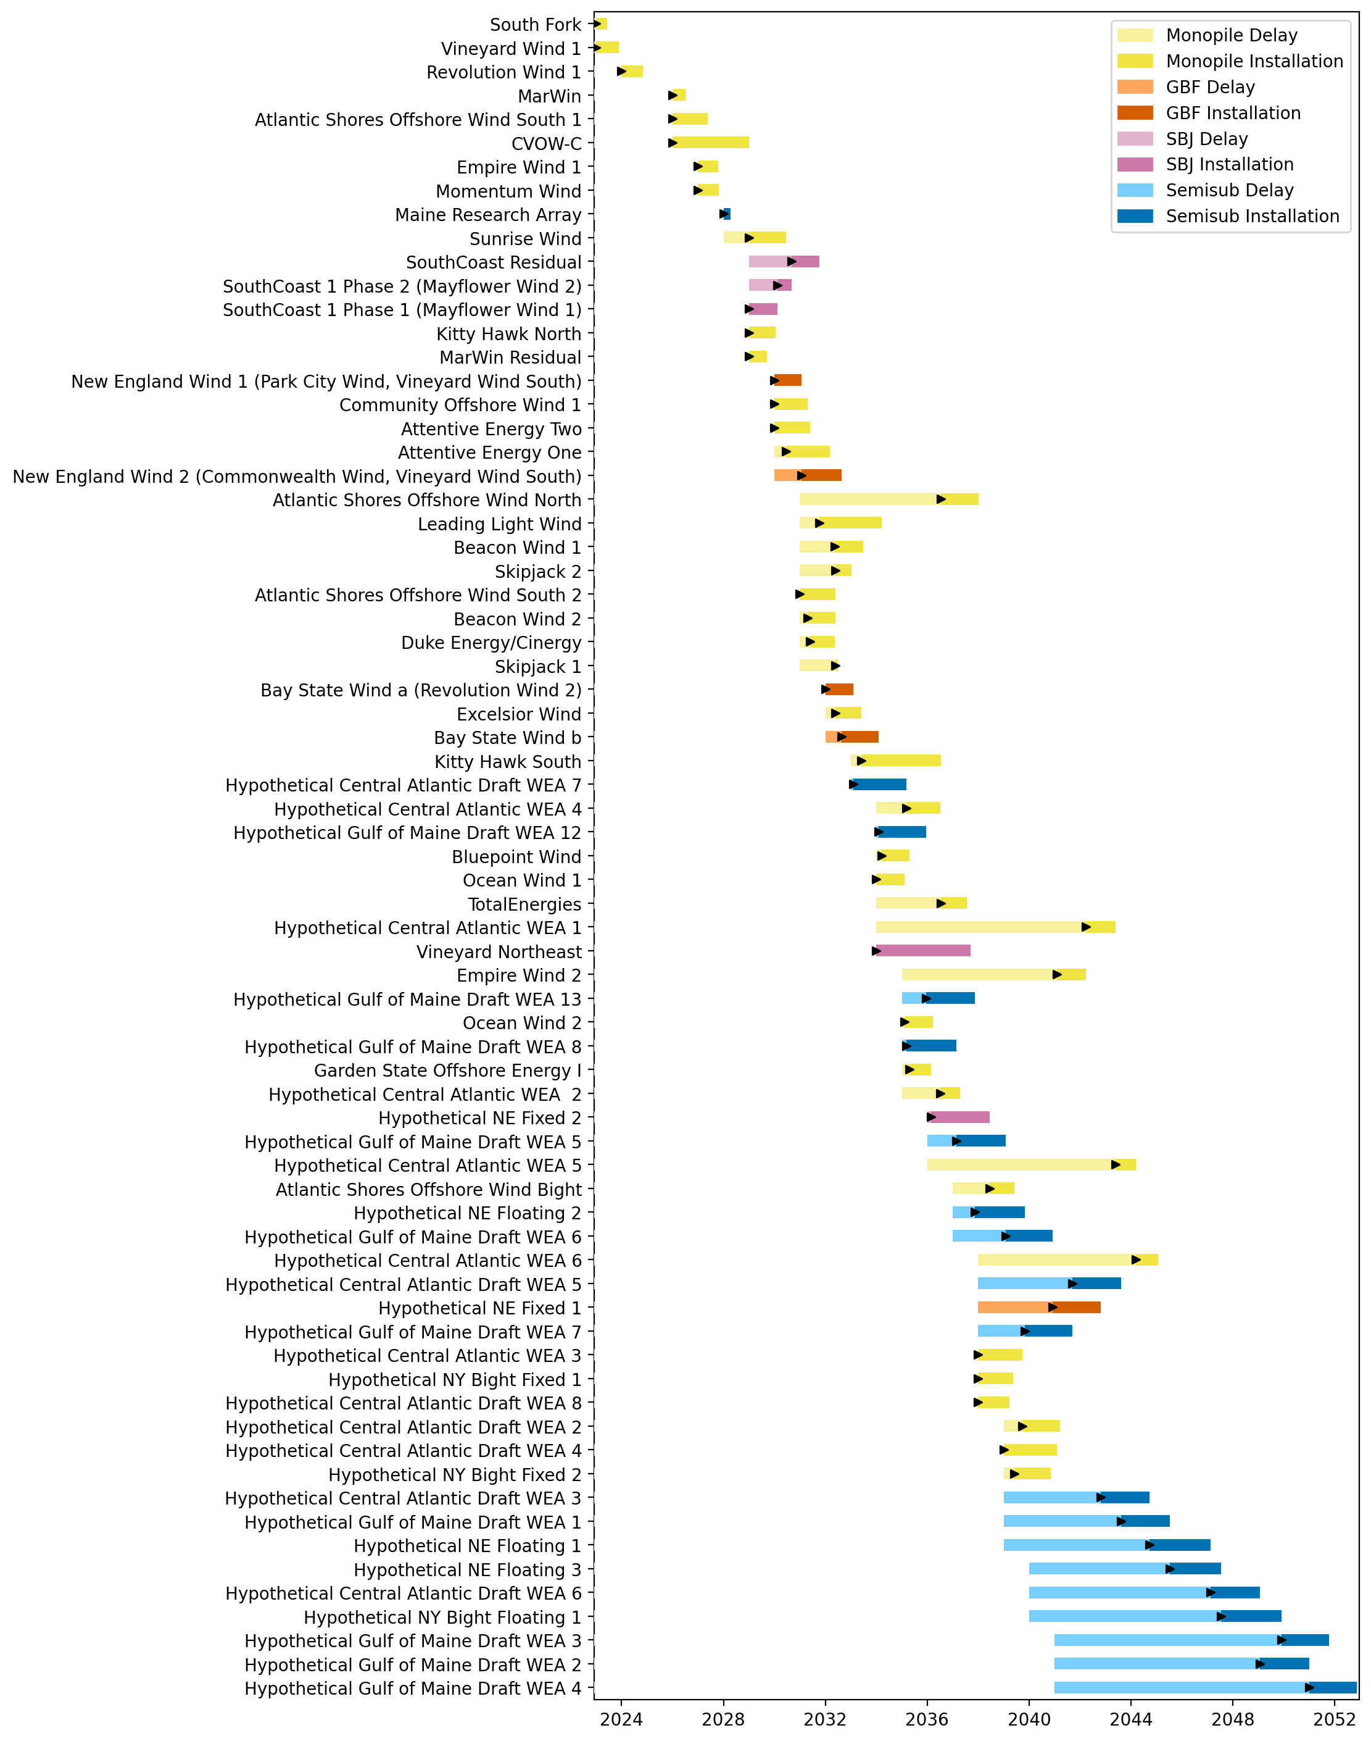
Sorted Full Gantt

Slide 22
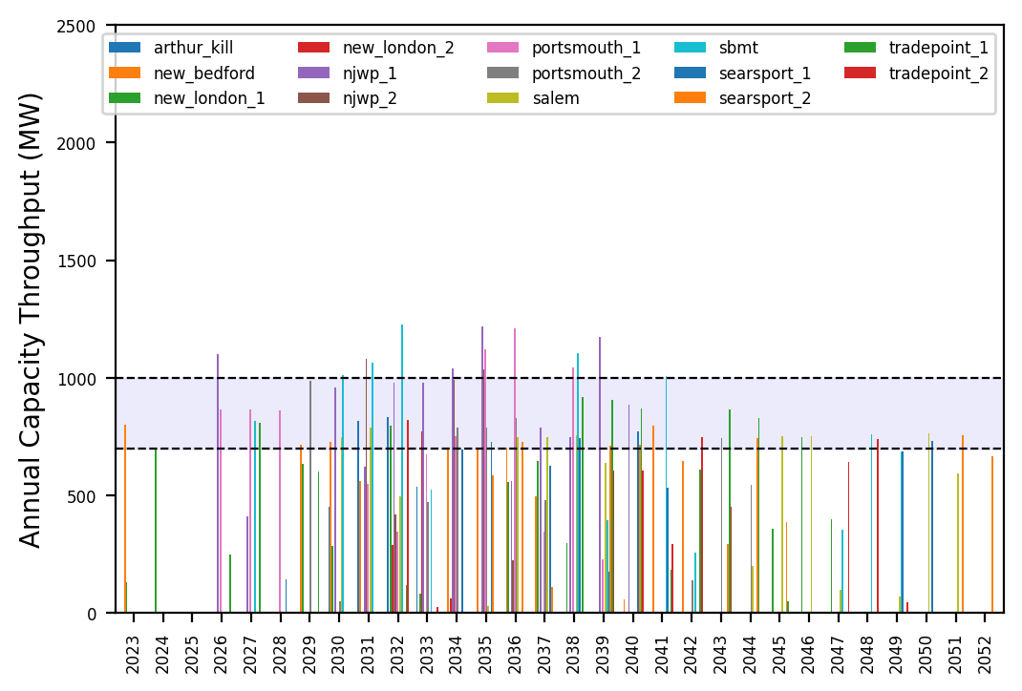
Port Throughput

Slide 23
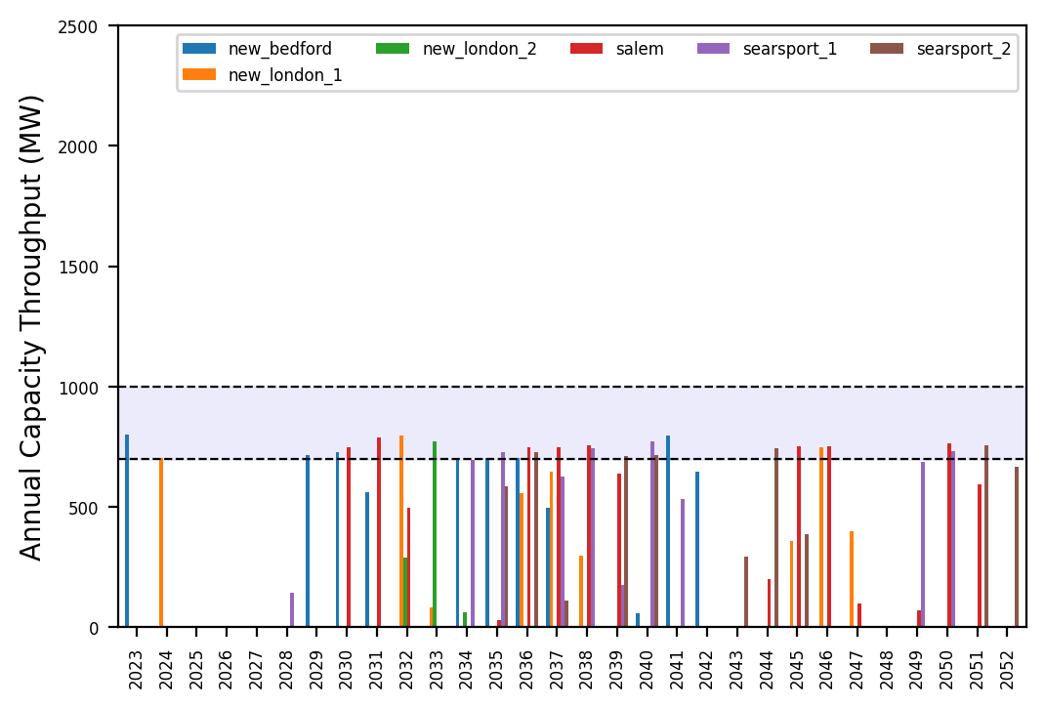
Port Throughput

Slide 24
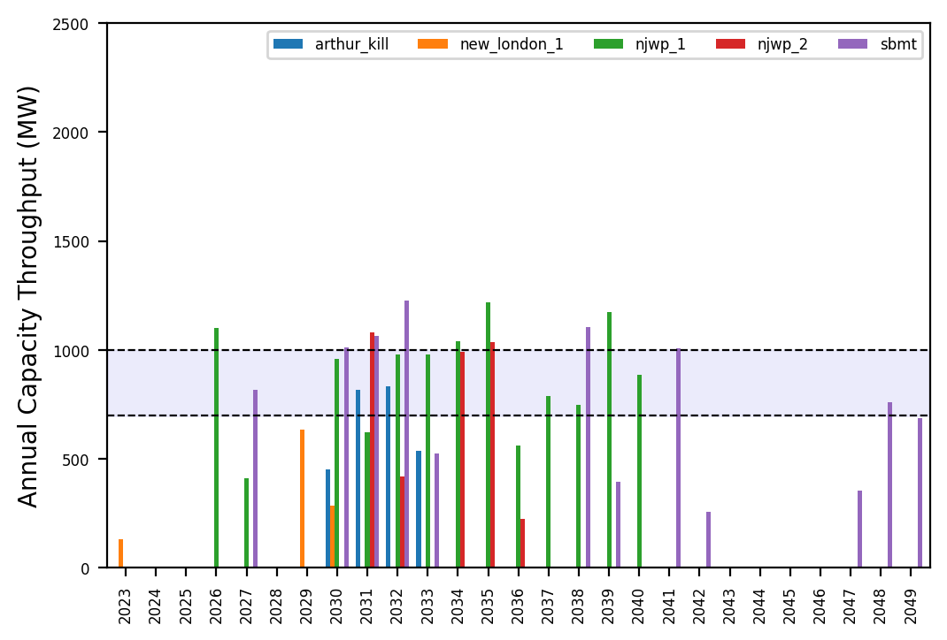
Port Throughput

Slide 25
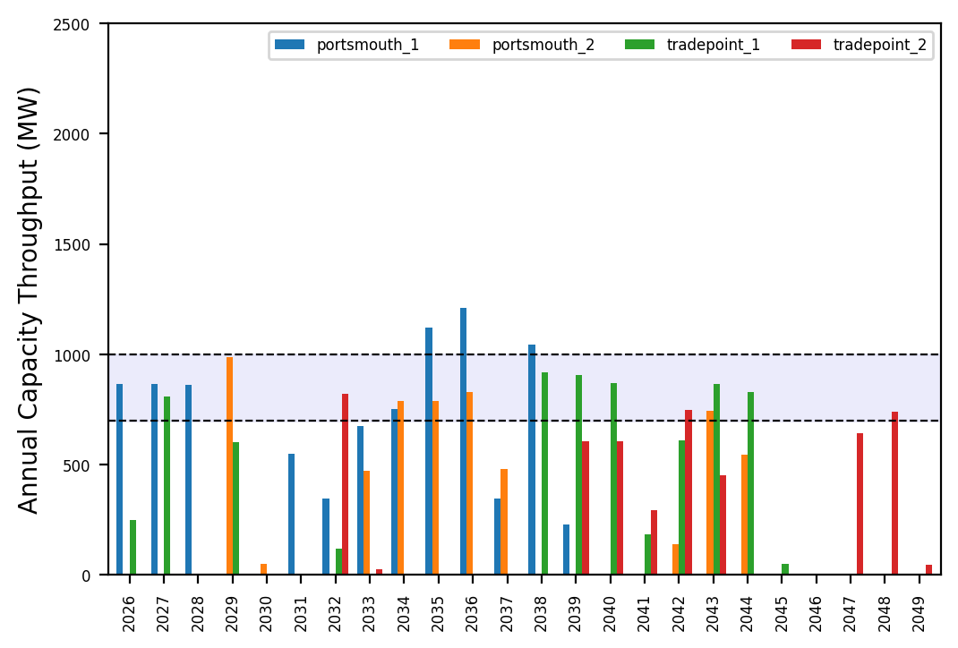
Port Throughput

Slide 26
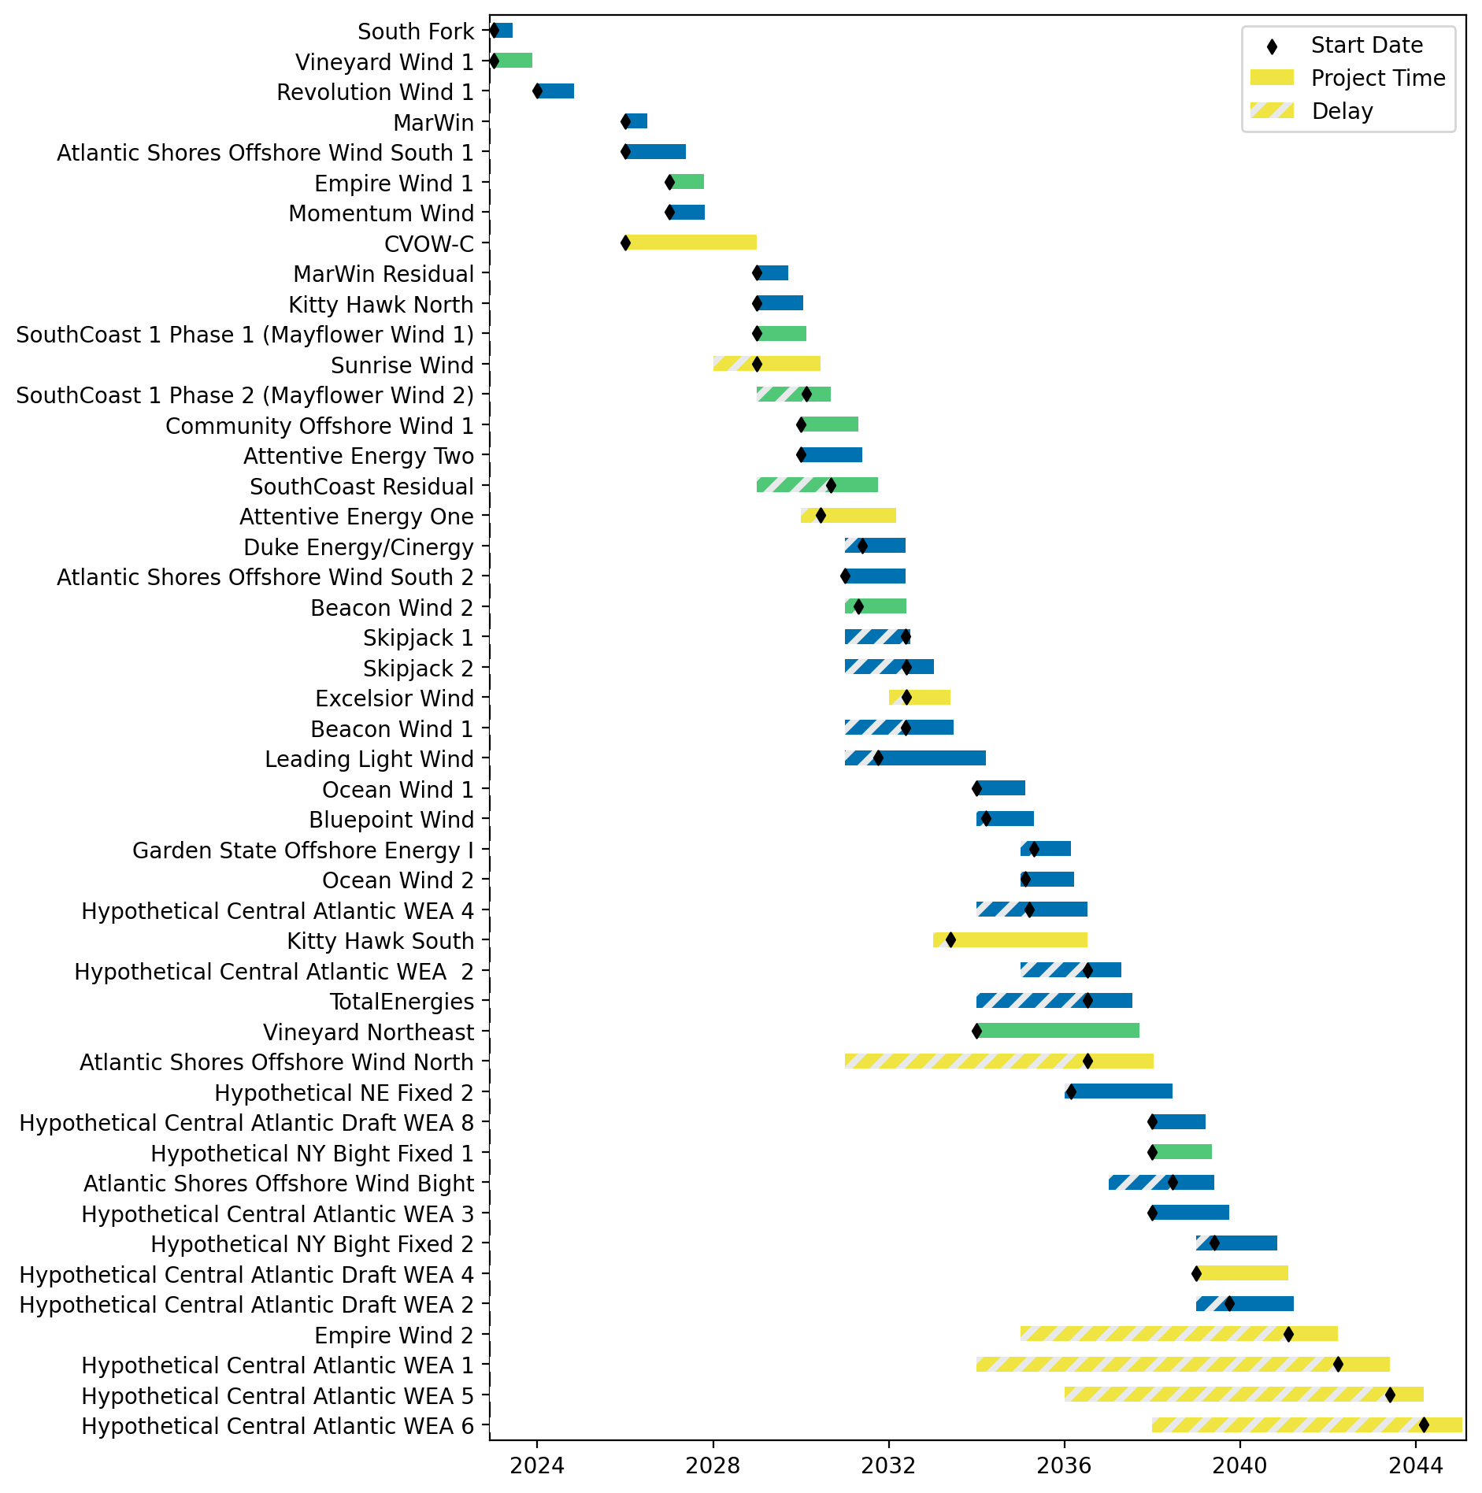
Fixed Gantt

Slide 27
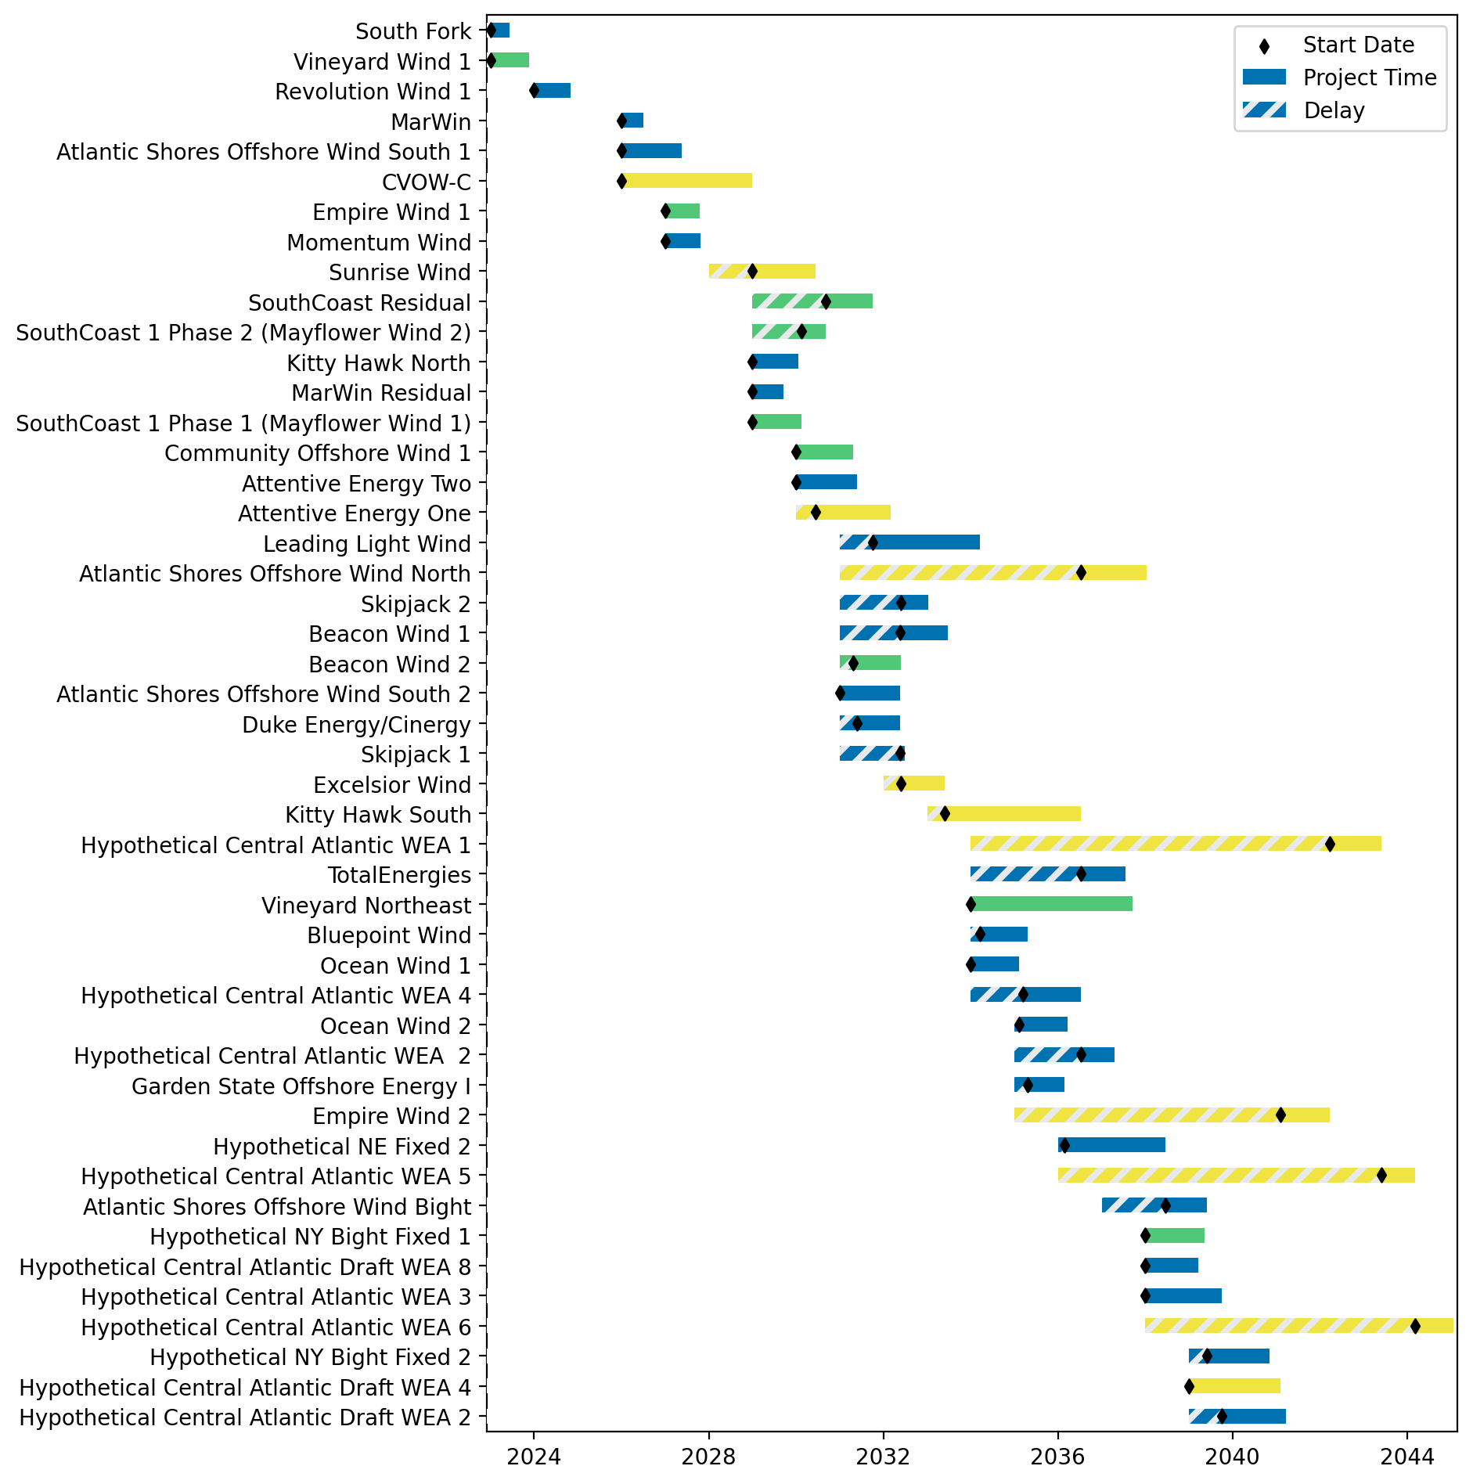
Sorted Fixed Gantt

Slide 28
natl_gaps_5foreign
1 more foreign WTIV 2025

Slide 29

Full Gantt

Slide 30
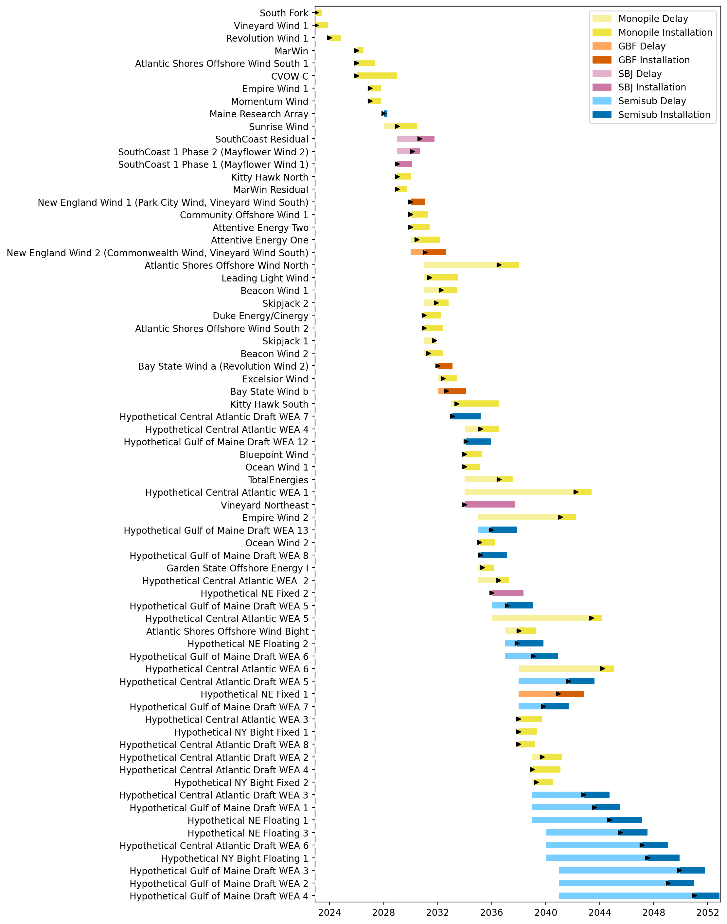
Sorted Full Gantt

Slide 31
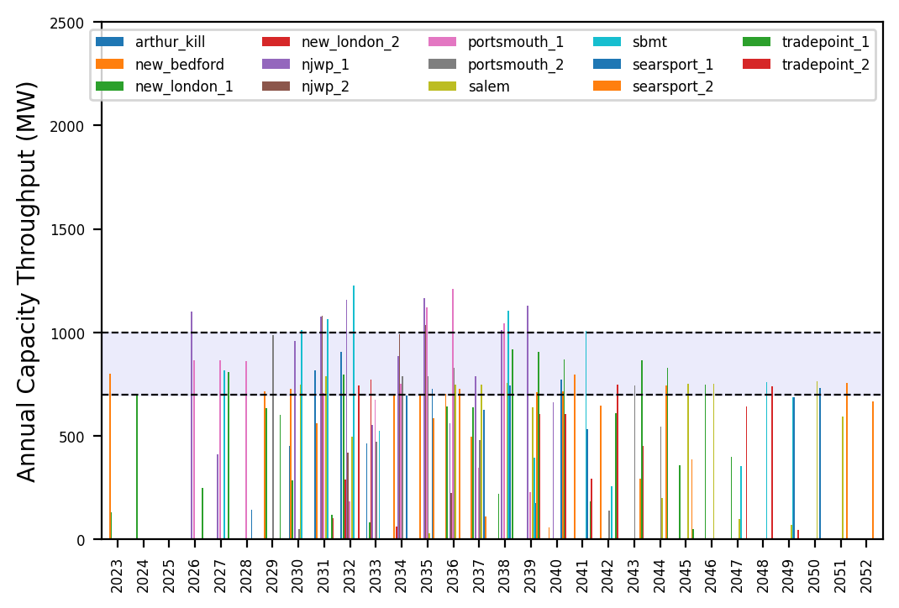
Port Throughput

Slide 32
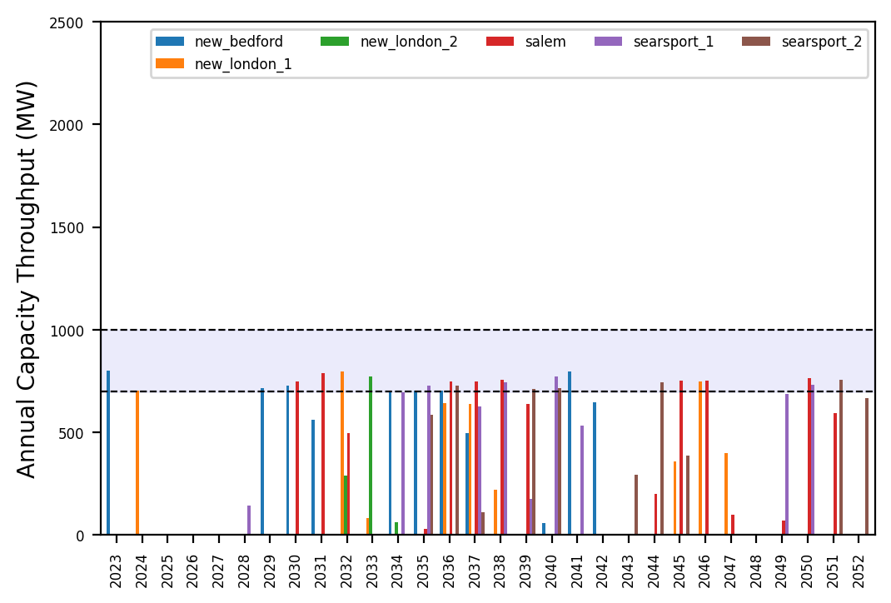
Port Throughput

Slide 33
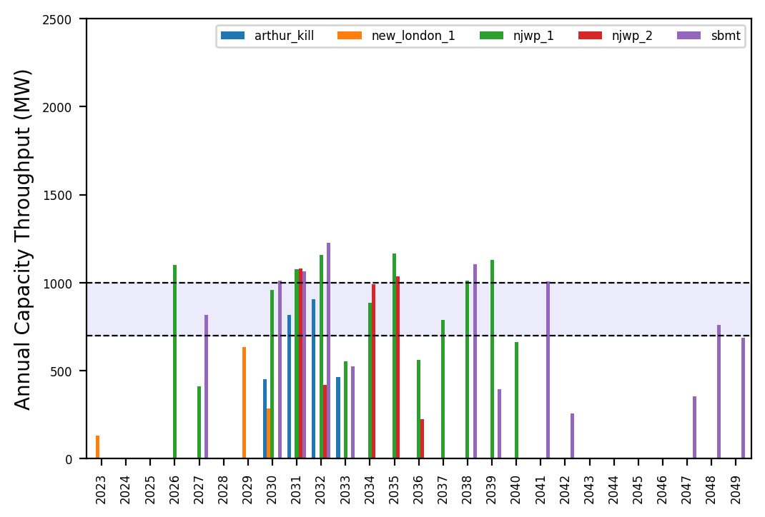
Port Throughput

Slide 34
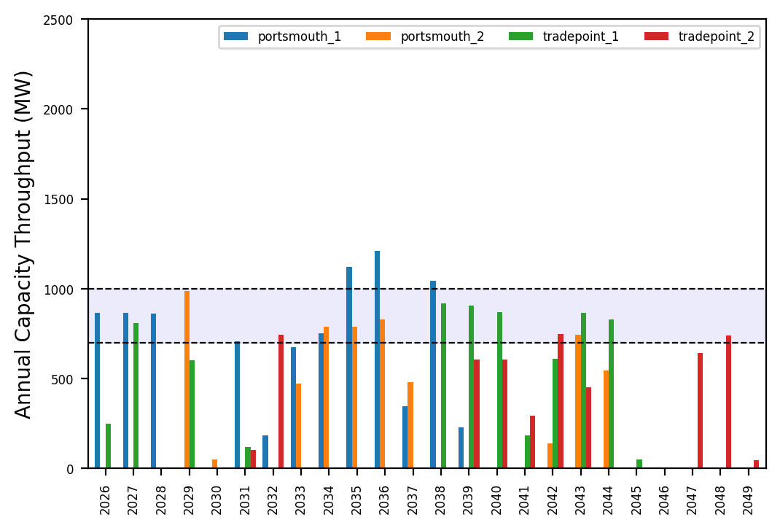
Port Throughput

Slide 35

Fixed Gantt

Slide 36
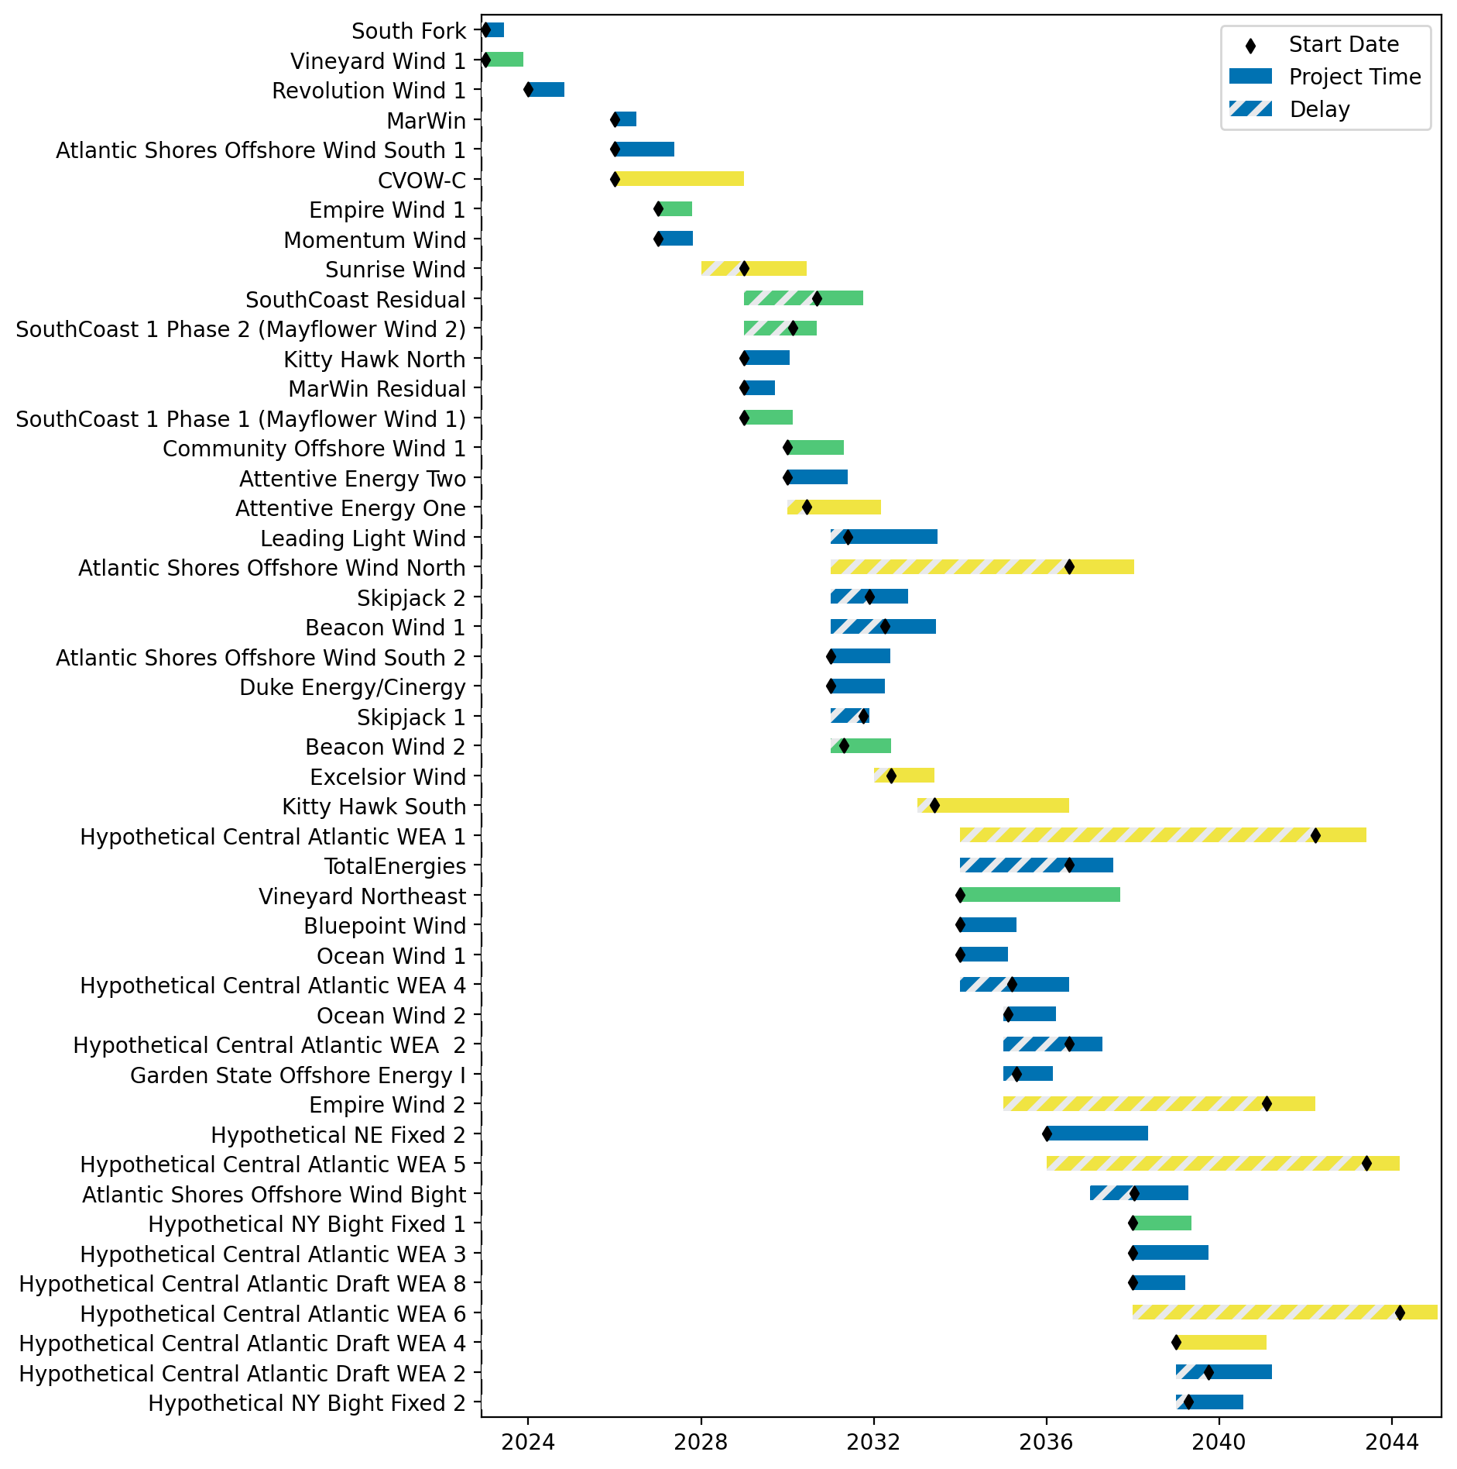
Sorted Fixed Gantt

Slide 37
natl_gaps_6foreign
1 more foreign WTIV 2025

Slide 38
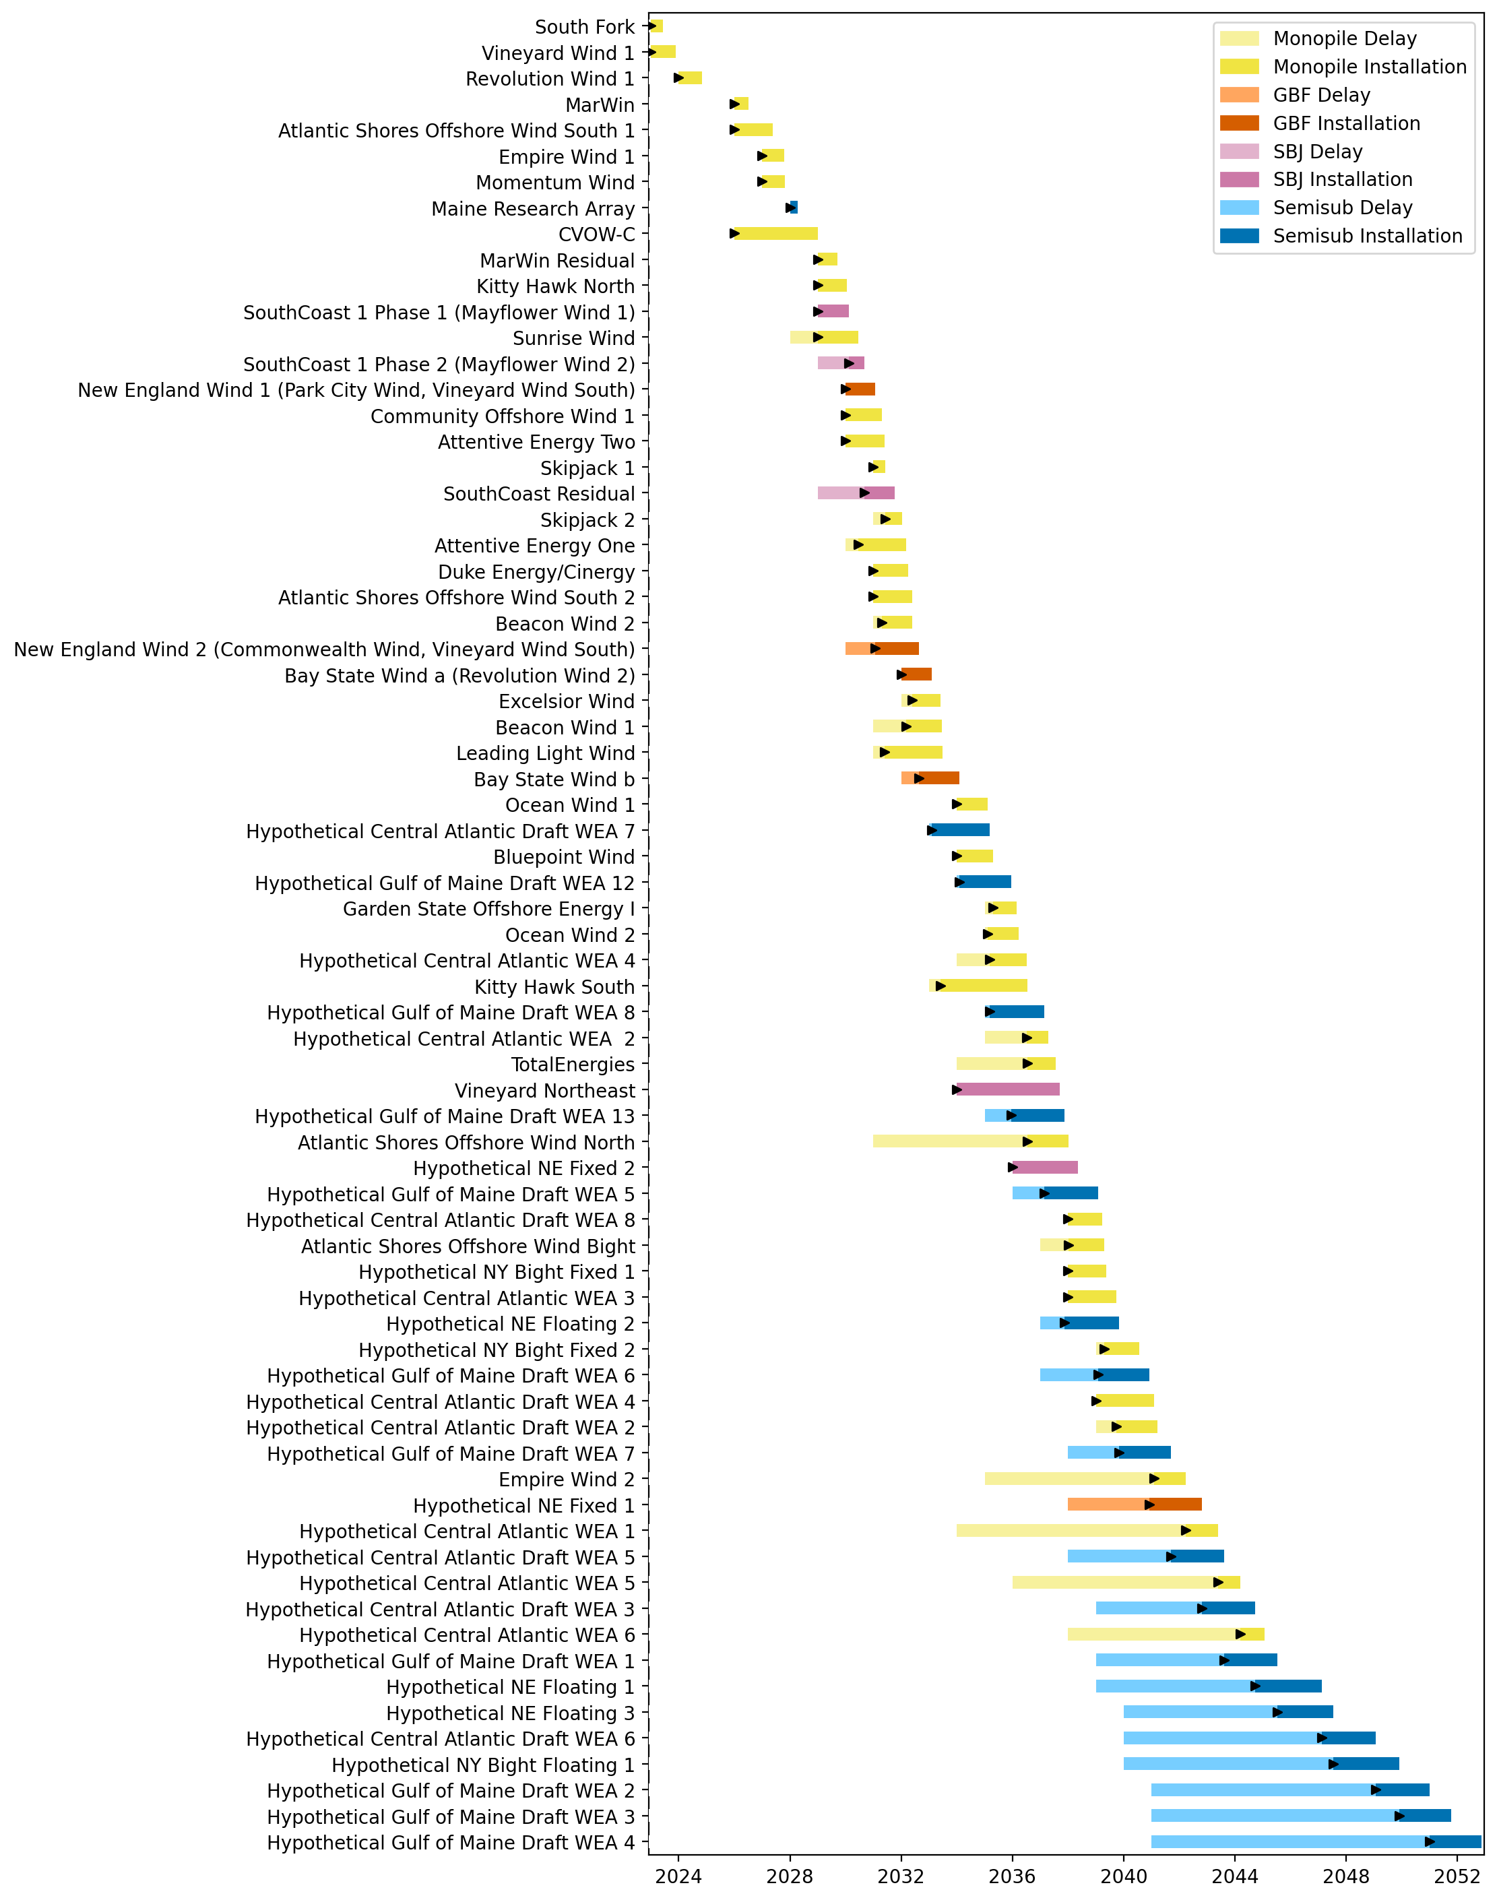
Full Gantt

Slide 39
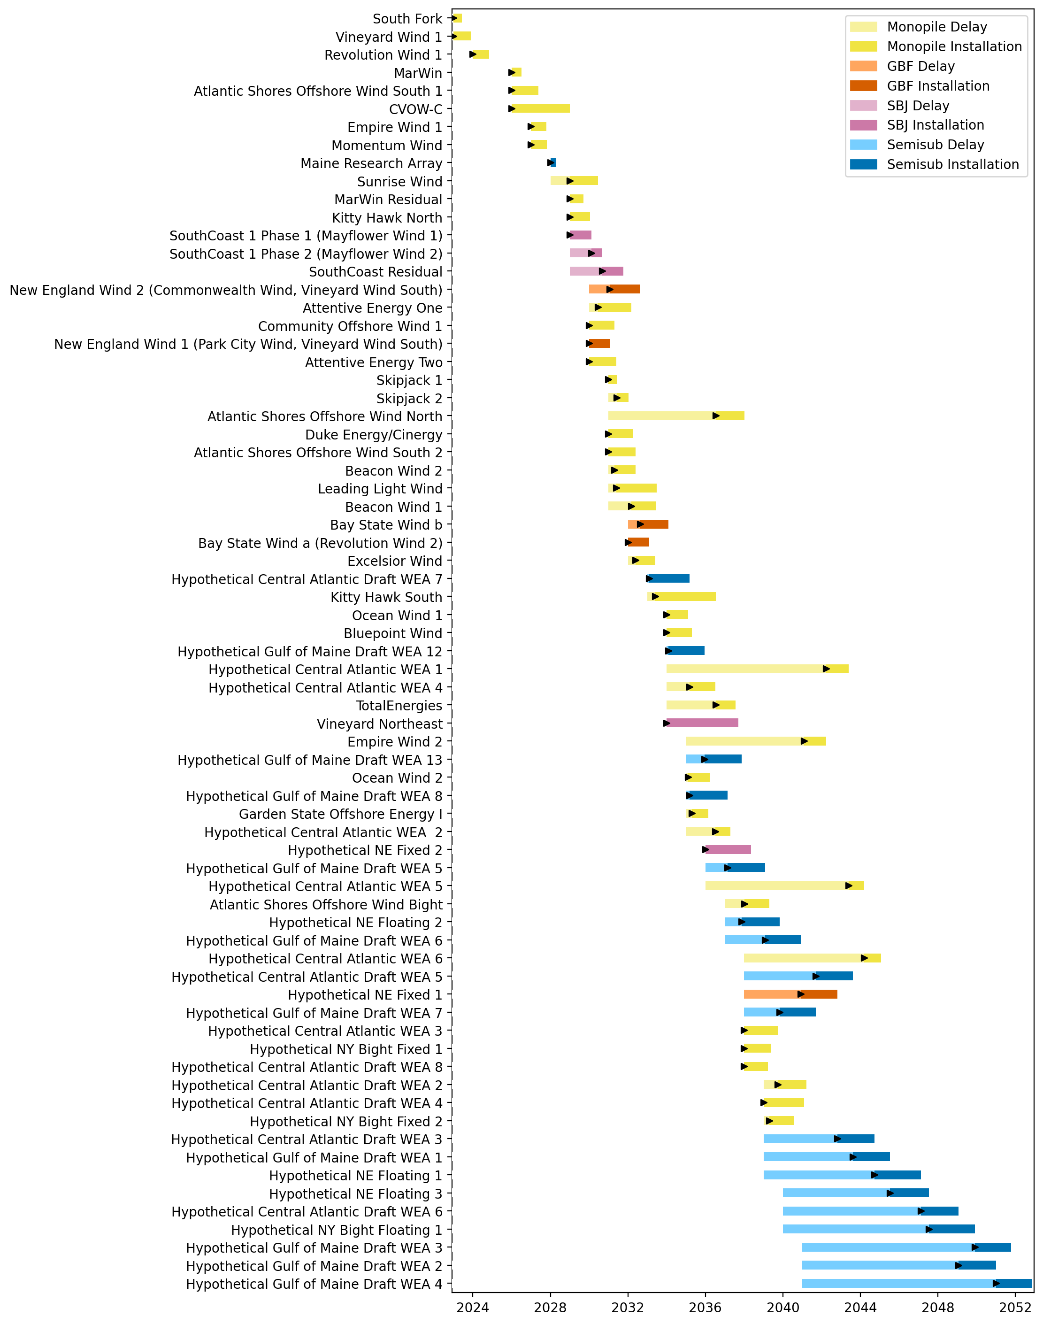
Sorted Full Gantt

Slide 40
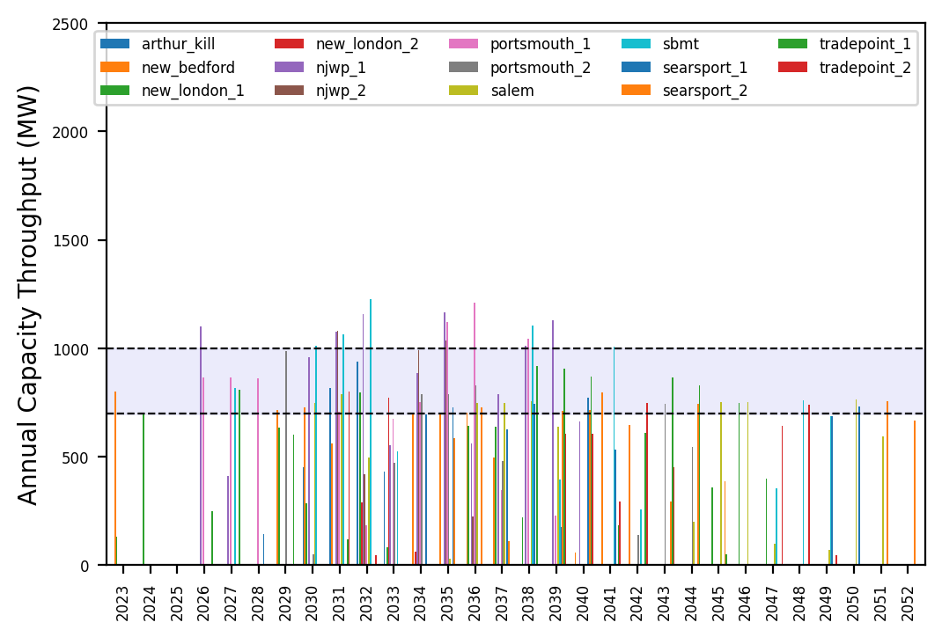
Port Throughput

Slide 41
Port Throughput

Slide 42
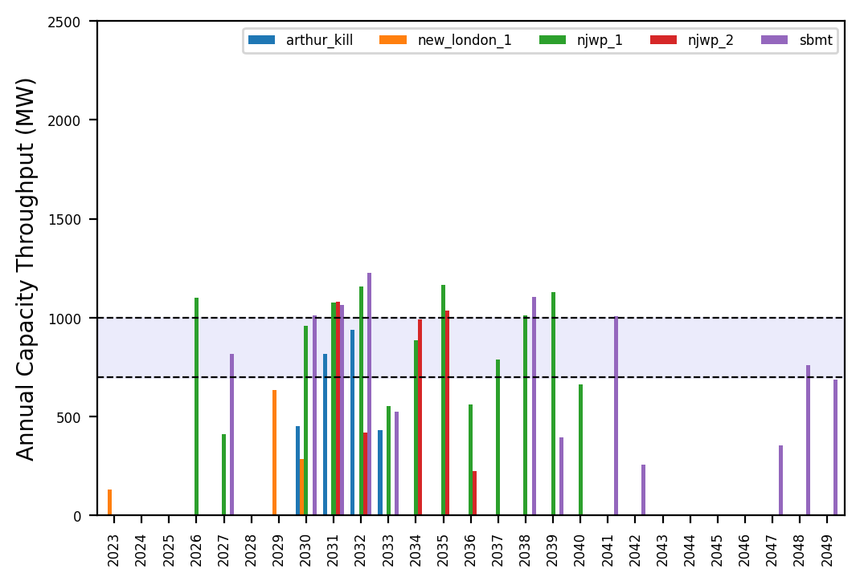
Port Throughput

Slide 43
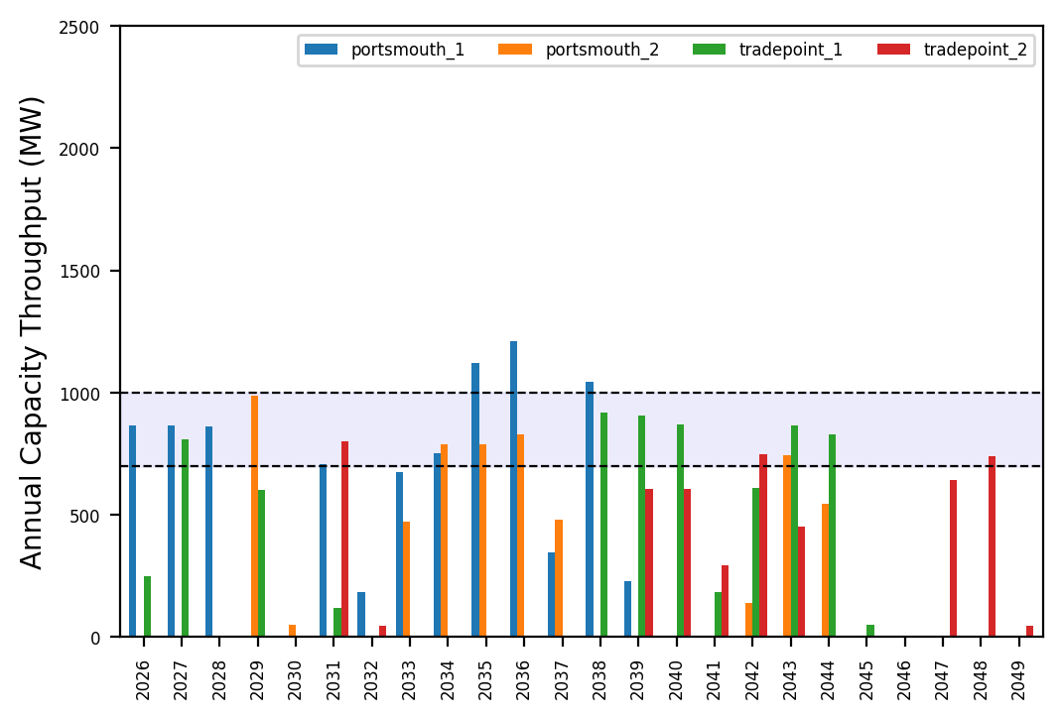
Port Throughput

Slide 44

Fixed Gantt

Slide 45

Sorted Fixed Gantt

Slide 46
natl_gaps_6foreign_infp
1 more foreign WTIV 2025

Slide 47
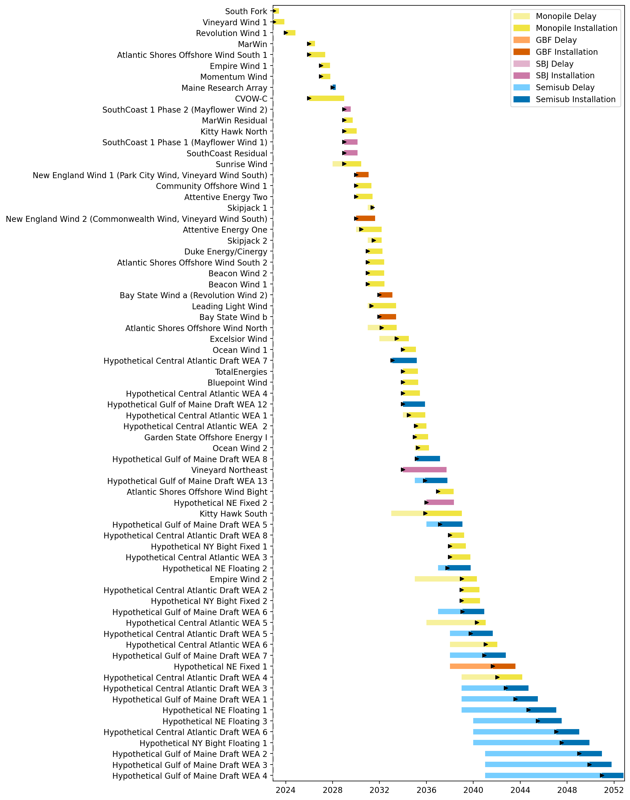
Full Gantt

Slide 48
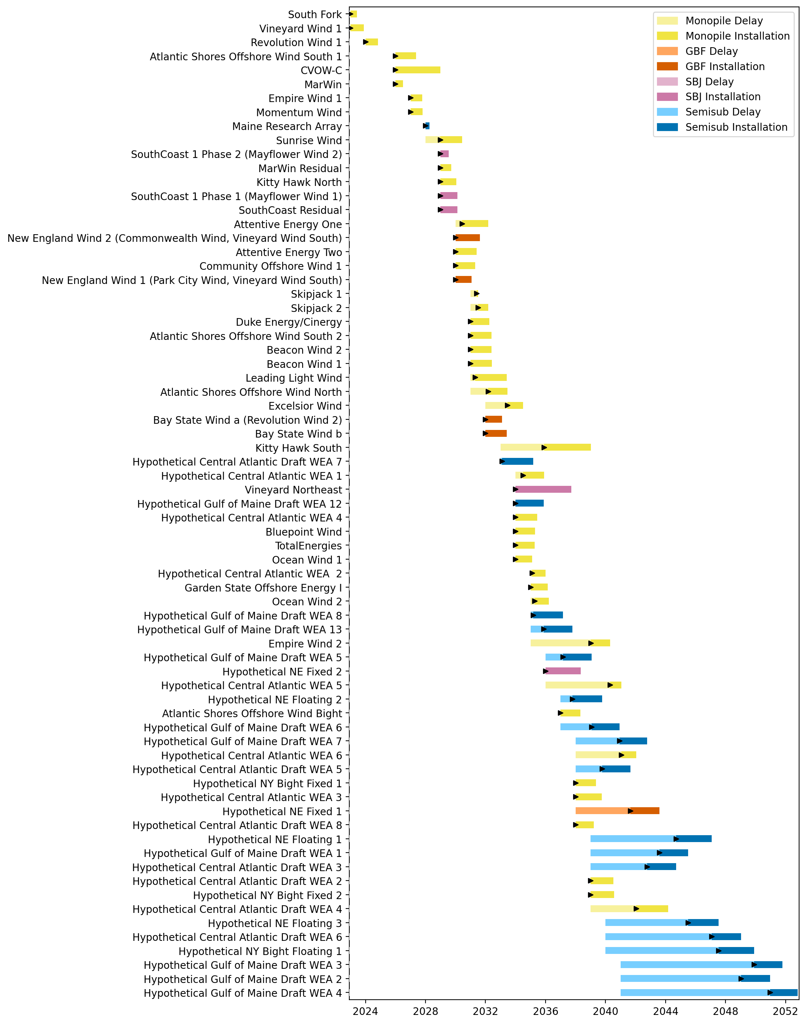
Sorted Full Gantt

Slide 49
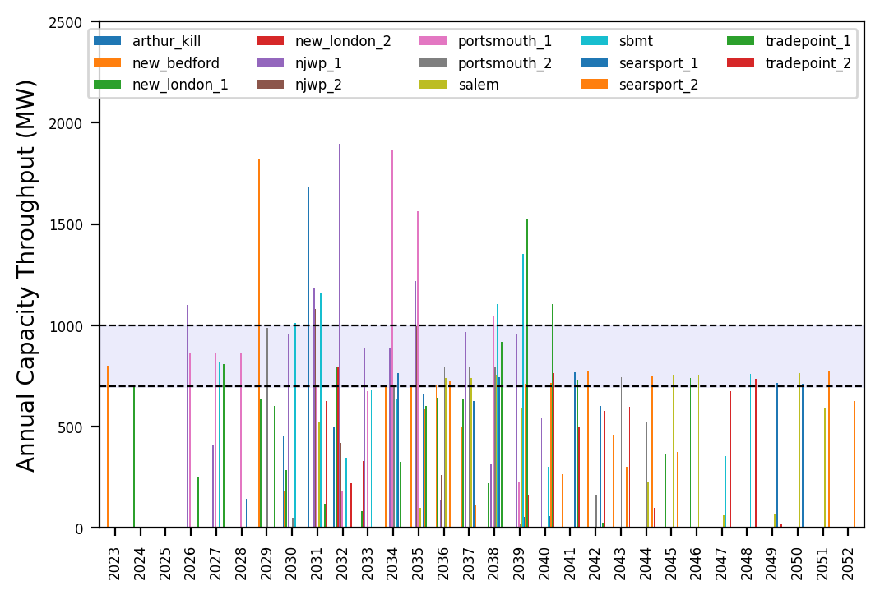
Port Throughput

Slide 50
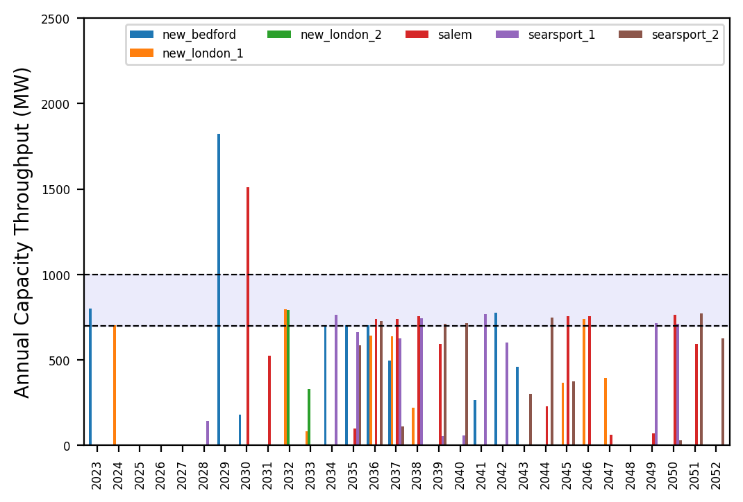
Port Throughput

Slide 51
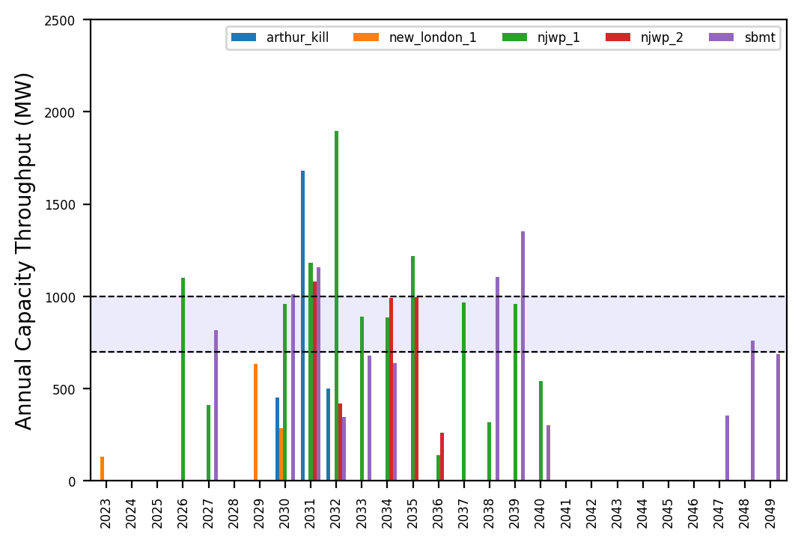
Port Throughput

Slide 52
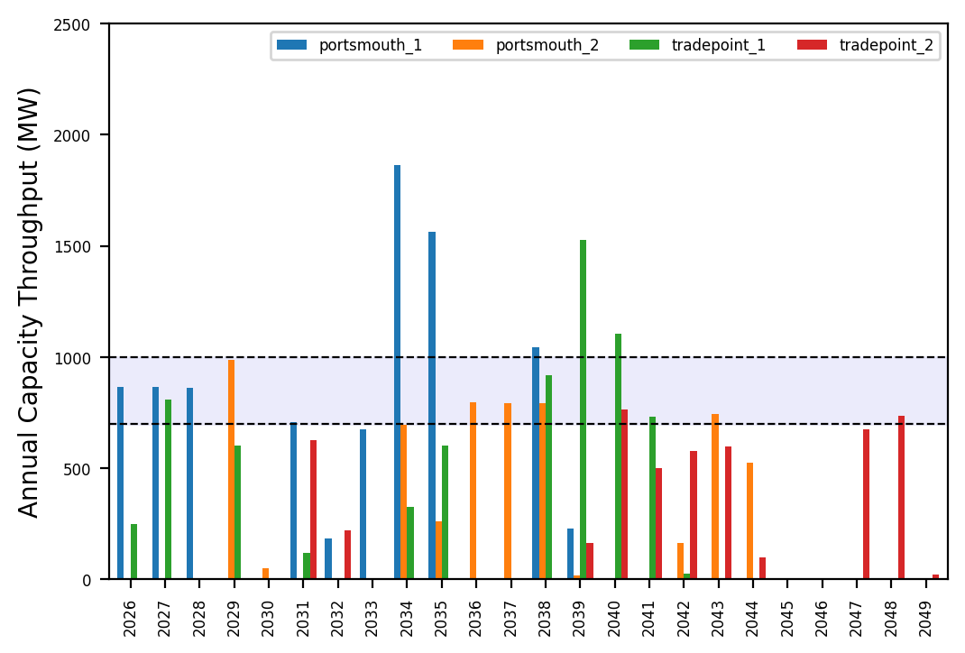
Port Throughput

Slide 53
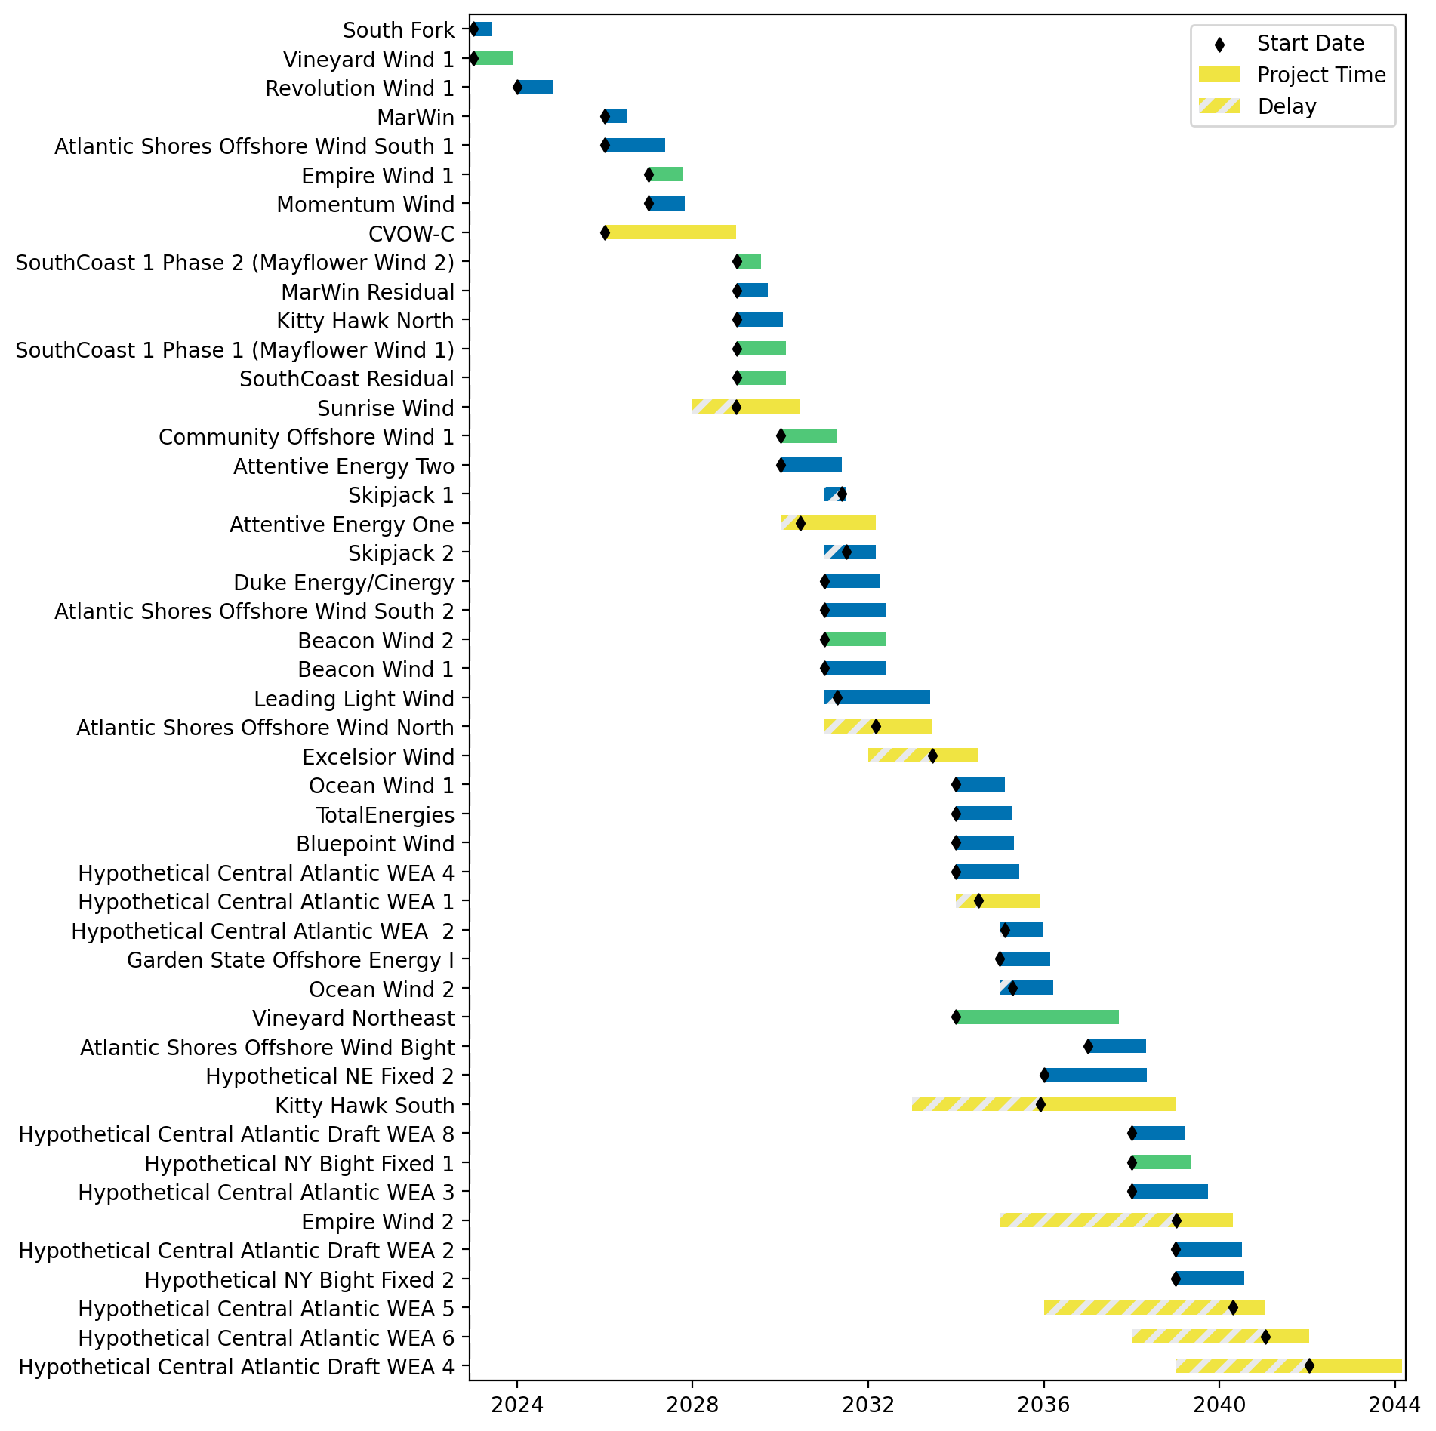
Fixed Gantt

Slide 54
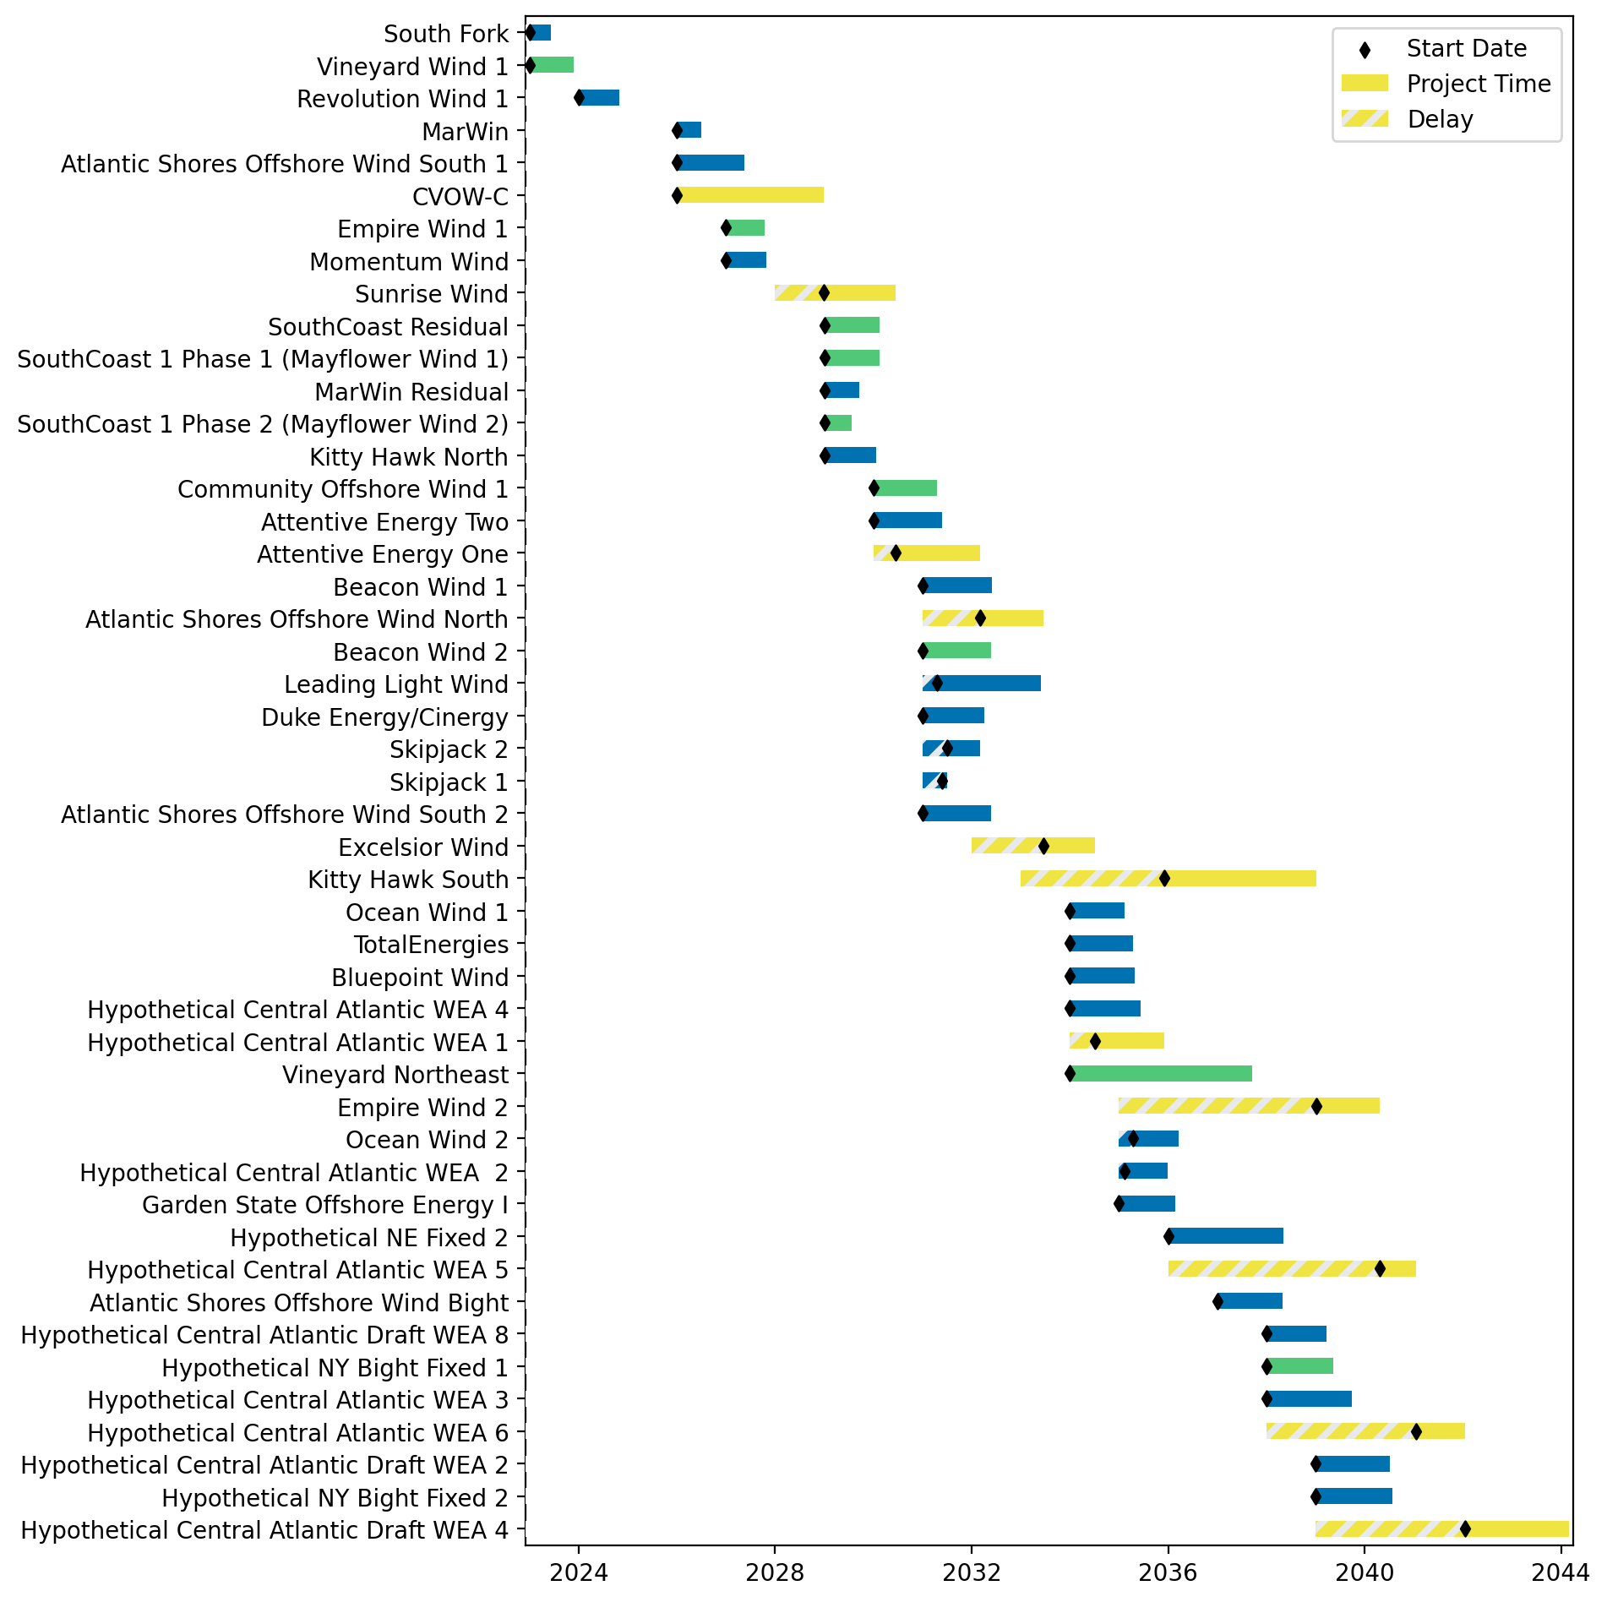
Sorted Fixed Gantt

Slide 55
natl_gaps_infp_infv
1 US WTIV starting with CVOW, then 1 in 2030, 2033, 2036

Slide 56
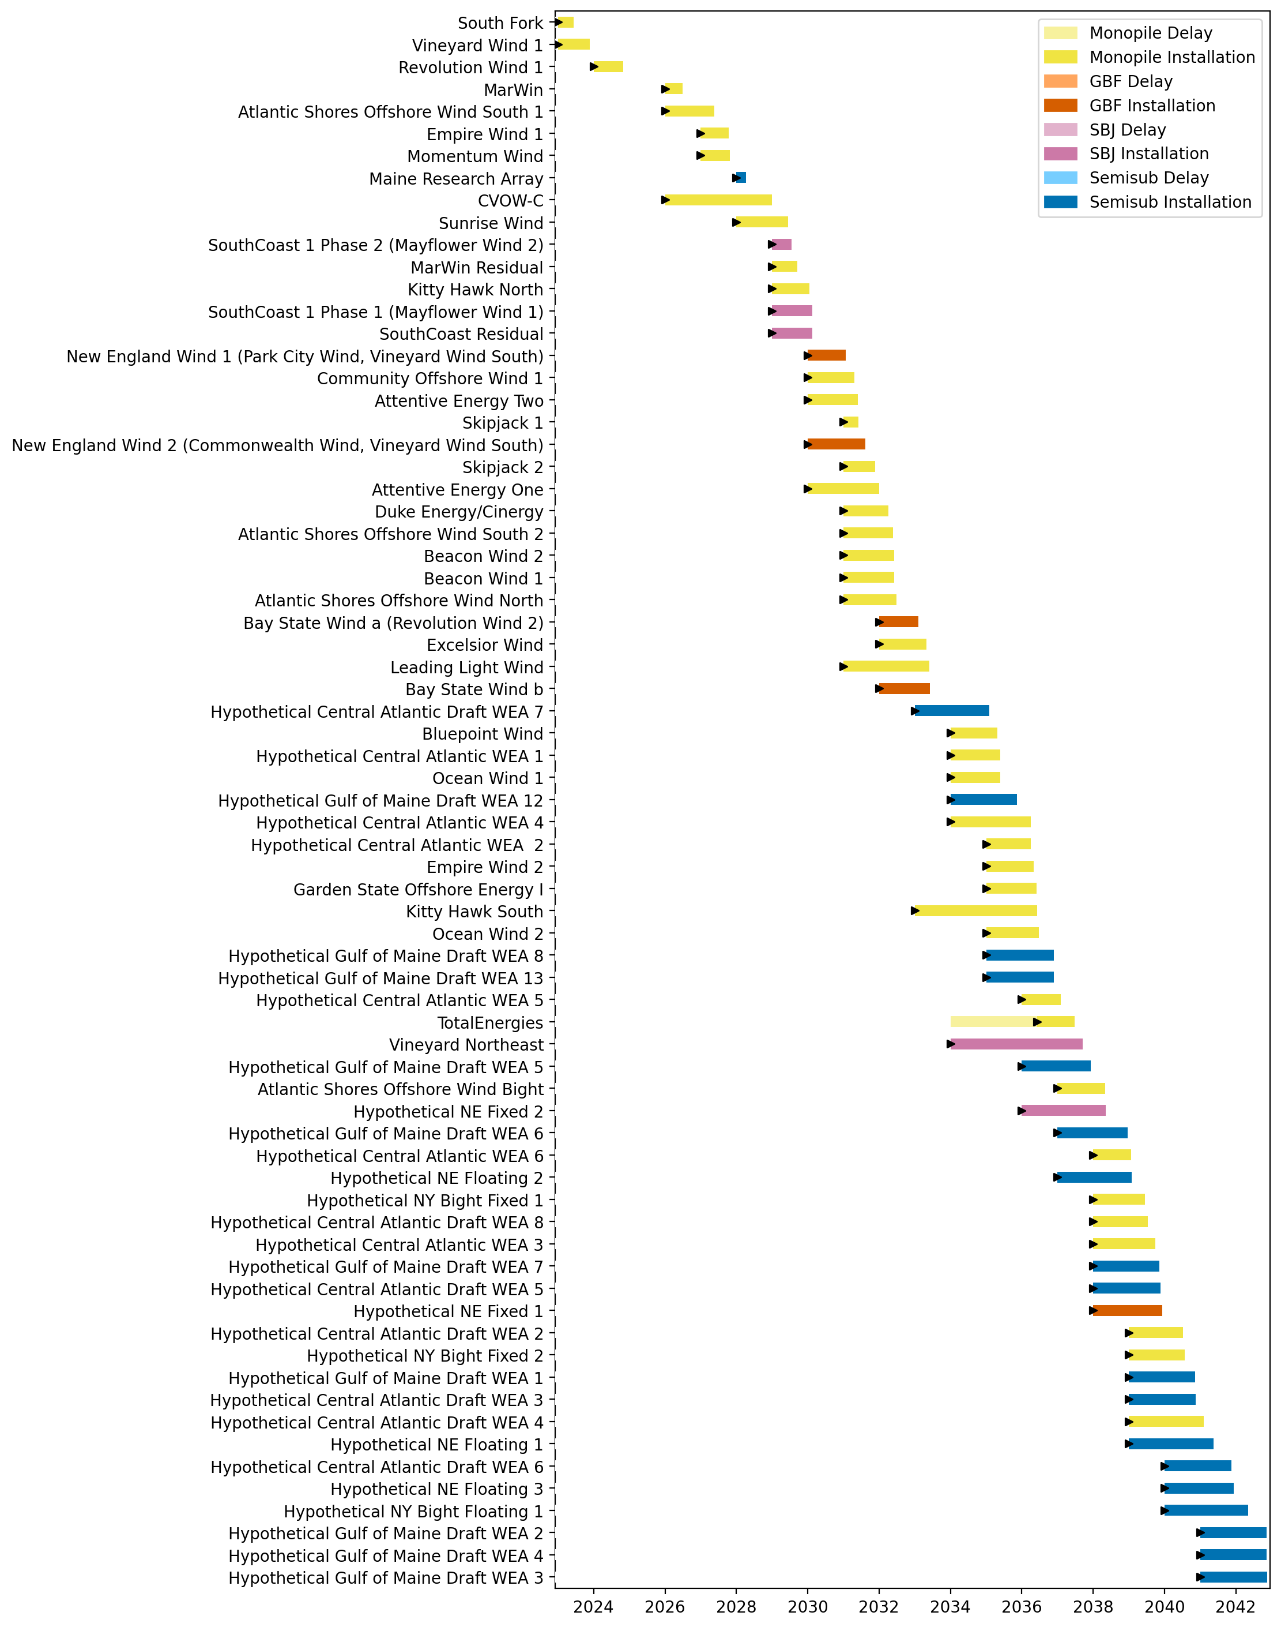
Full Gantt

Slide 57
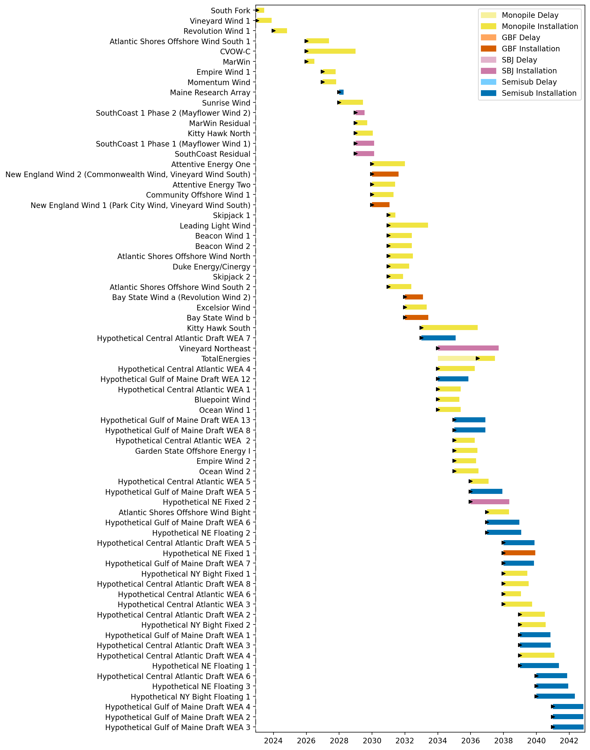
Sorted Full Gantt

Slide 58
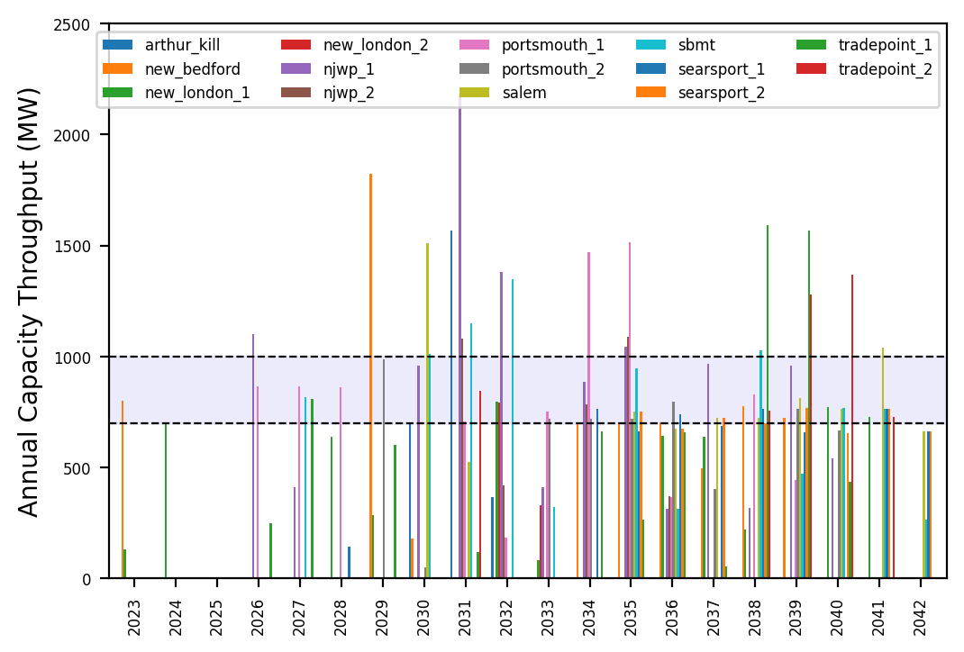
Port Throughput

Slide 59
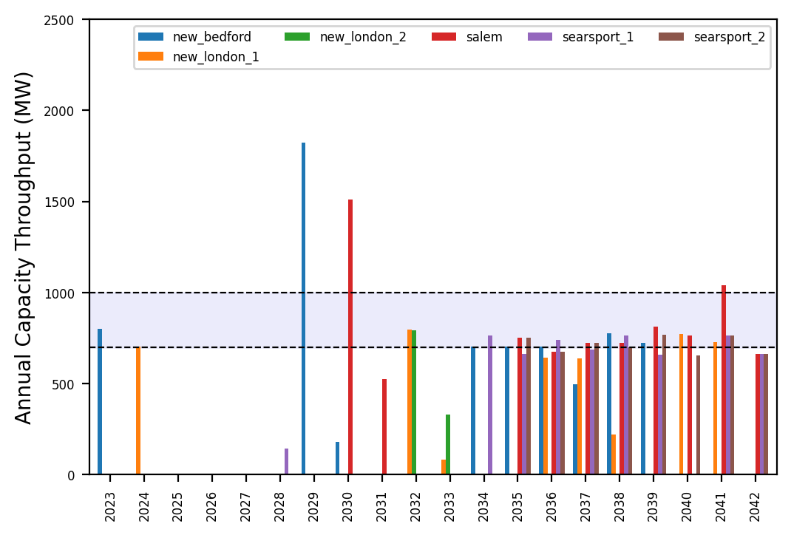
Port Throughput

Slide 60
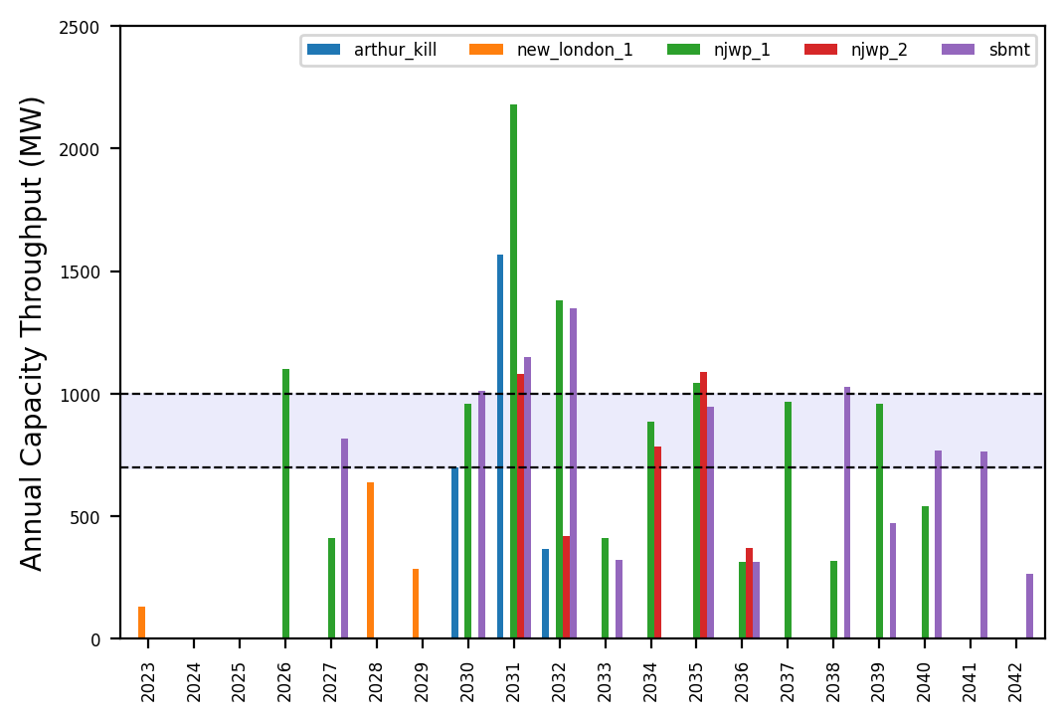
Port Throughput

Slide 61
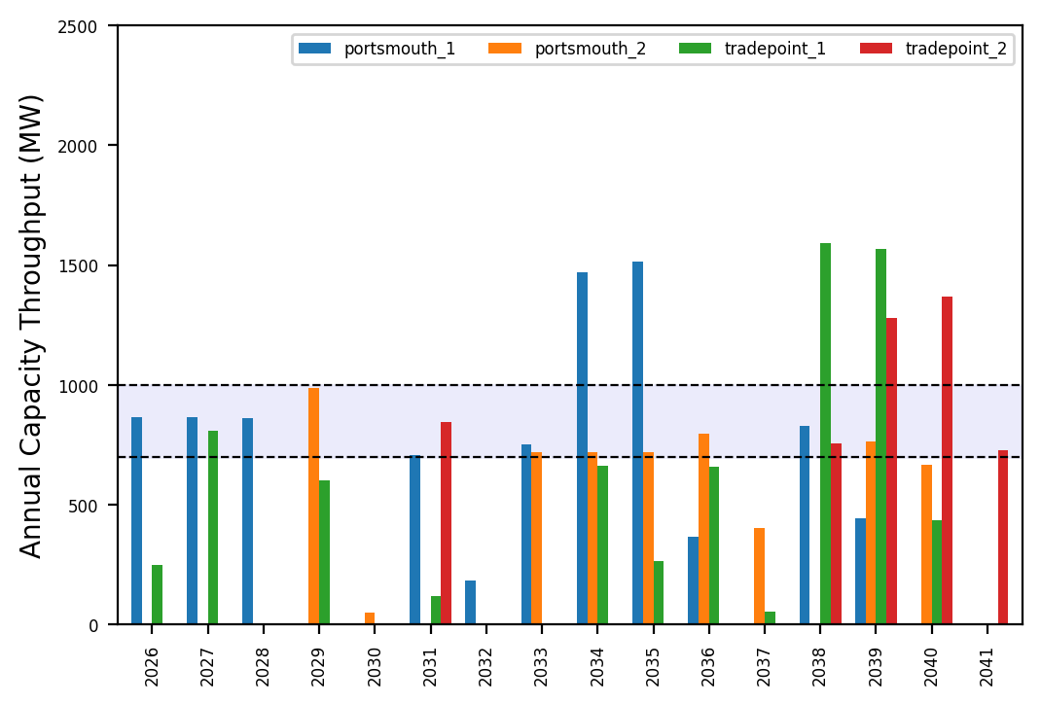
Port Throughput

Slide 62
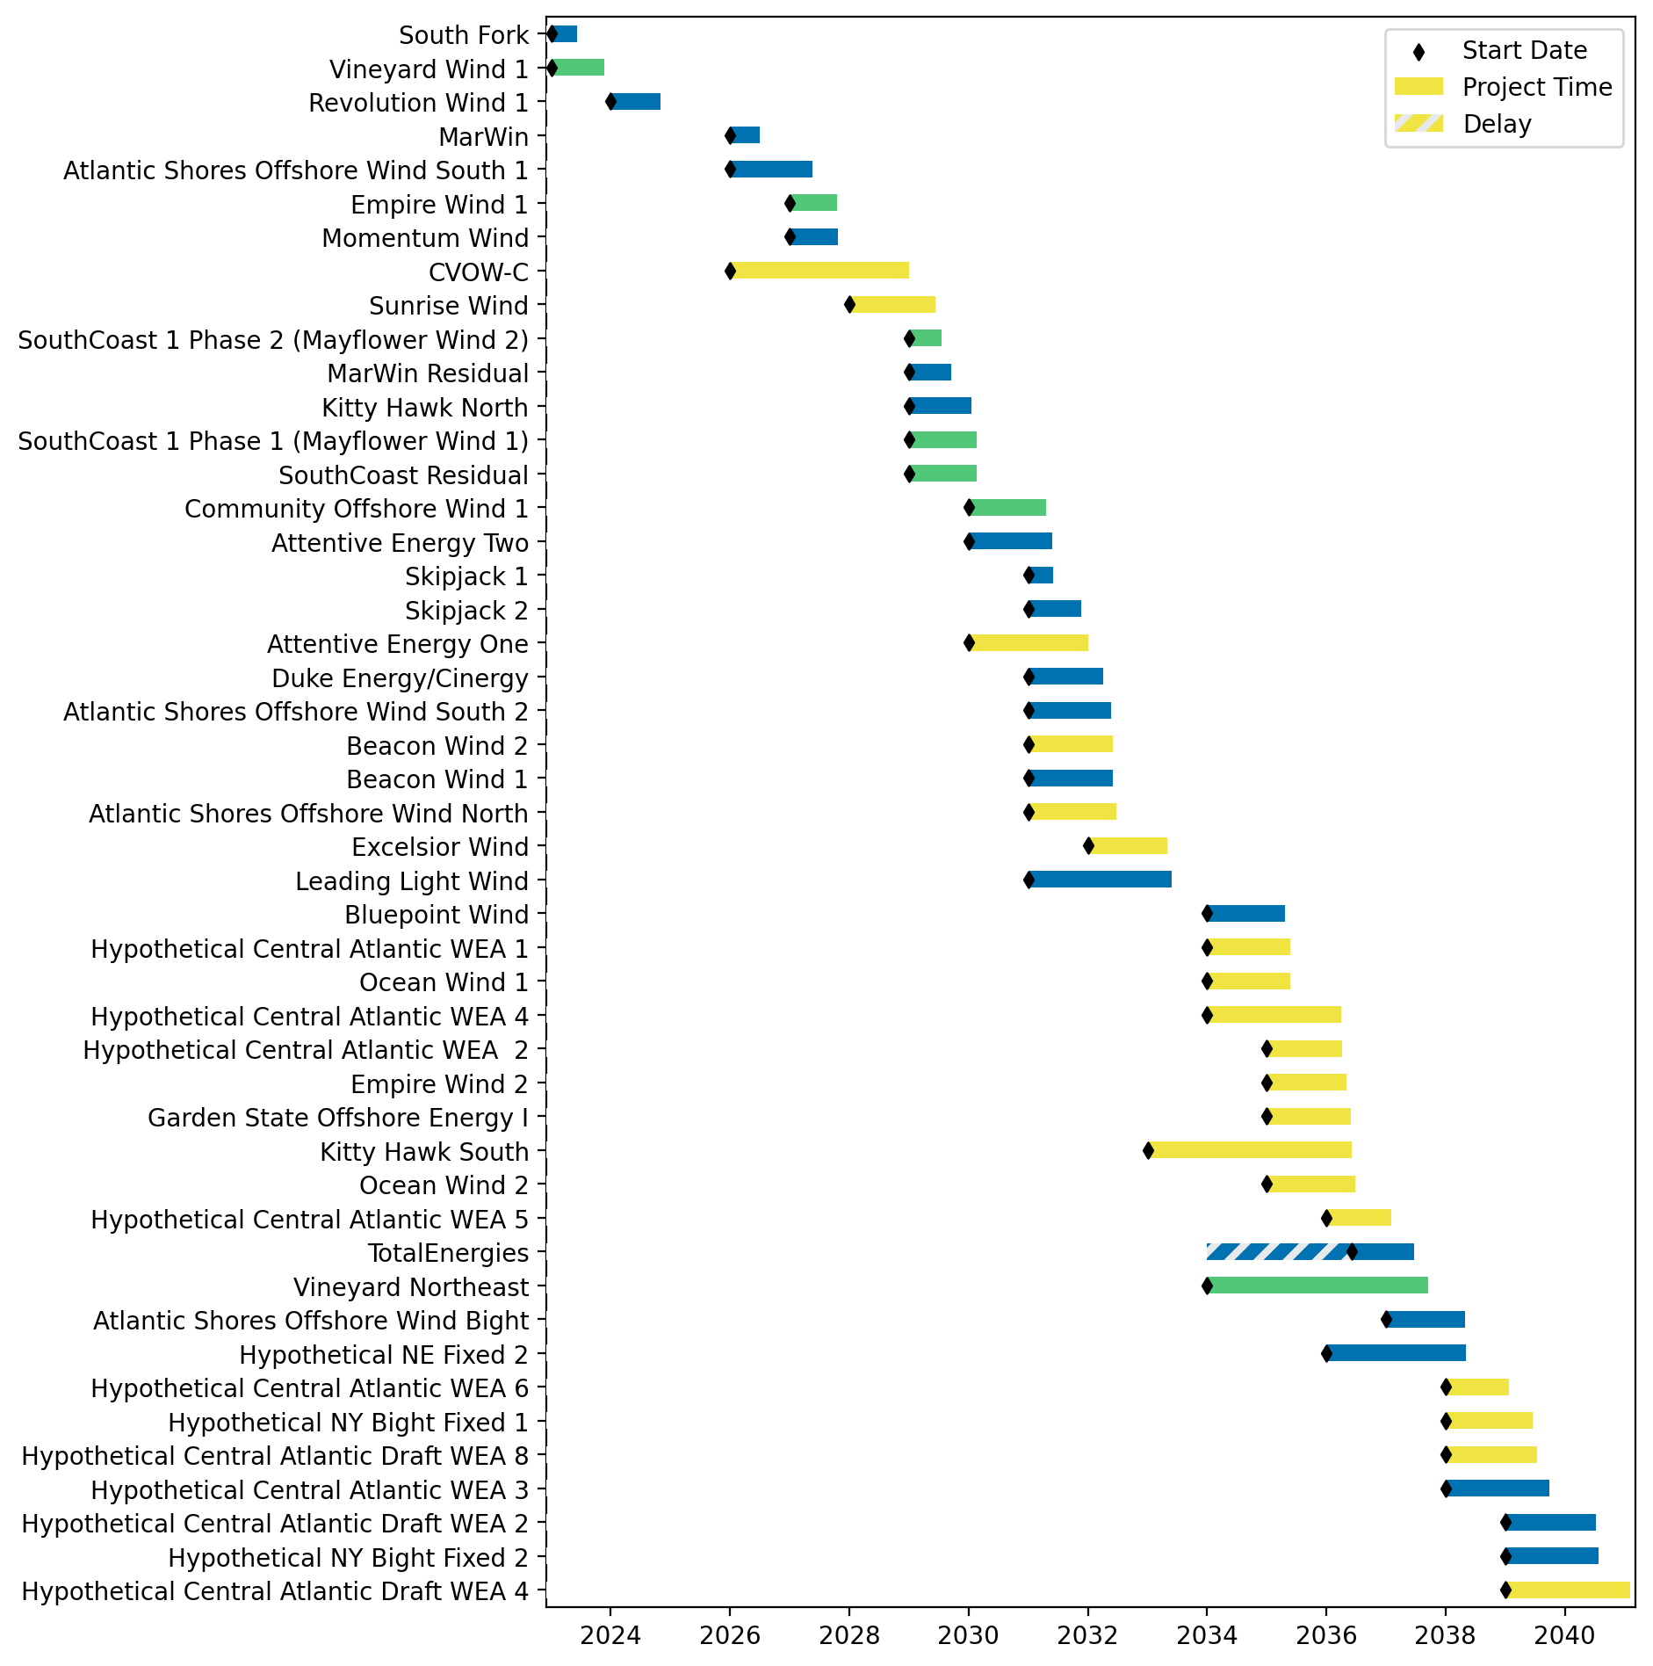
Fixed Gantt

Slide 63

Sorted Fixed Gantt

Slide 64

Installed Capacity

